Slide 1
Report to City Council:
June 2026 Monthly Financial Update
City Council Meeting – July 16, 2026

Slide 2
Presentation Outline
Purpose of Monthly Financial Briefing
How Monthly Financial Briefings Help Council
General Fund Summary
Water Utility Fund Summary
Wastewater Utility Fund Summary
Storm Drainage Utility Fund Summary
FY 2026 Cost Containment Measures Implemented by ICM

Slide 3
FY 2025-26 MONTHLY FINANCIAL BRIEFING
JUNE 2026

Slide 4
Purpose of Monthly Financial Briefing
  The City of Kyle is committed to maintaining transparency, accountability, and proactive
  financial stewardship.
  Monthly financial reporting provides City Council with timely information
  regarding the City's financial position and budget performance throughout the fiscal year.

Slide 5
Monthly Financial Briefings Help Council...
  Monitor Financial Performance by comparing actual revenues and expenditures to the adopted budget throughout the year.
  Identify Emerging Trends Early to detect revenue shortfalls, expenditure pressures, or operational changes before they become significant financial challenges.
  Support Informed Decision-Making by providing current financial information to assist with policy discussions, budget amendments, and strategic priorities.
  Enhance Fiscal Transparency by providing consistent, routine reporting on the City's major operating funds and overall financial condition.
  Evaluate Fund Balance Health through ongoing monitoring of reserves and projected year-end financial positions to ensure long-term fiscal sustainability.
  Improve Financial Accountability by promoting regular review of departmental spending and revenue collection activity against approved budgets.
  Support Long-Term Planning by identifying trends that may impact future budgets, service levels, and financial forecasts.
  Ensure Compliance with Financial Policies by monitoring progress toward adopted financial targets, reserve policies, and budgetary controls.

Slide 6
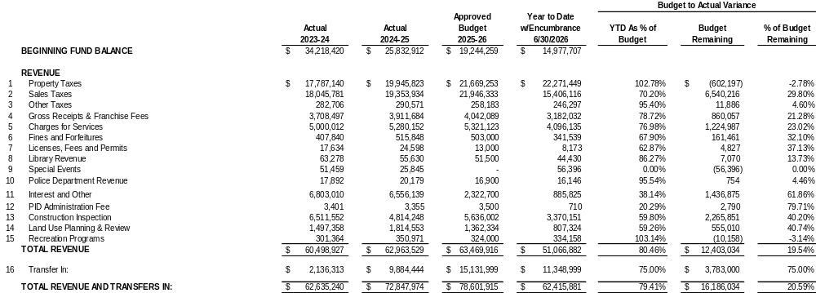
General Fund Summary

Slide 7
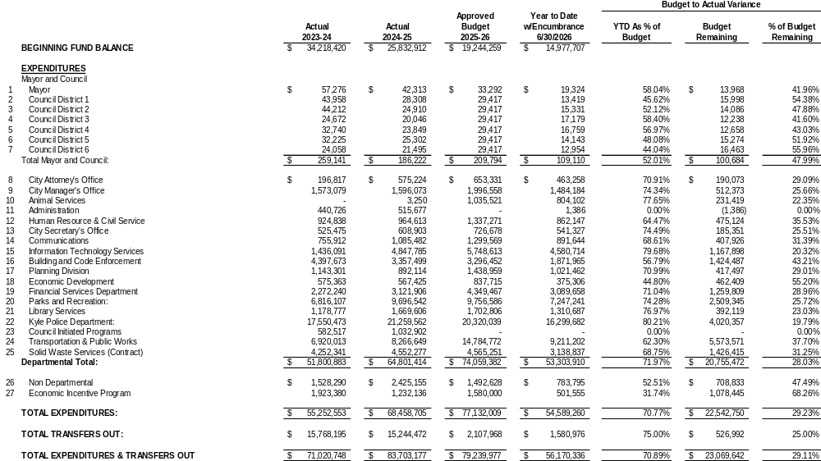
General Fund Summary

Slide 8
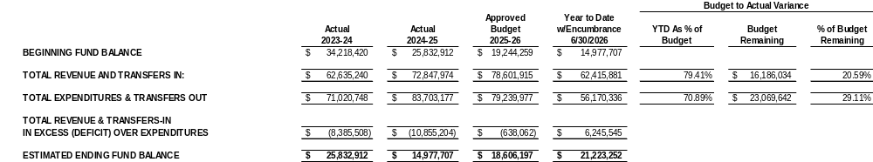
General Fund Summary

Slide 9
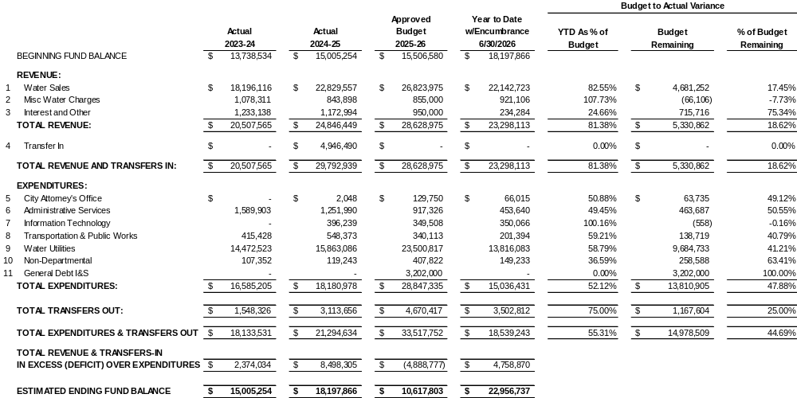
Water Utility Fund Summary

Slide 10
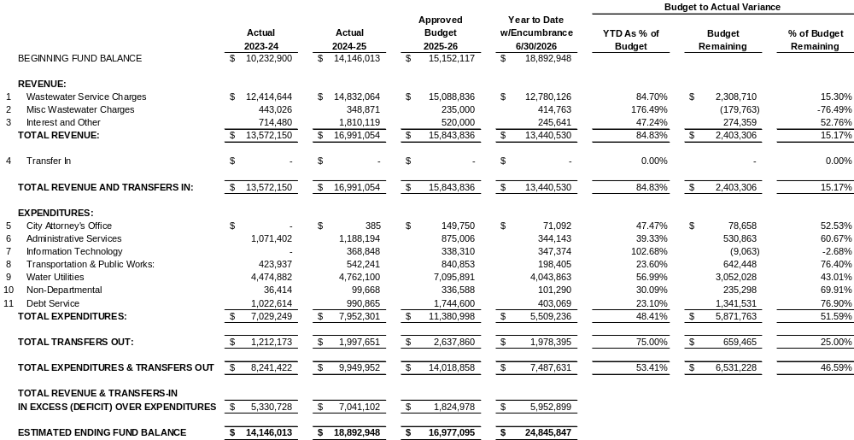
Wastewater Utility Fund Summary

Slide 11
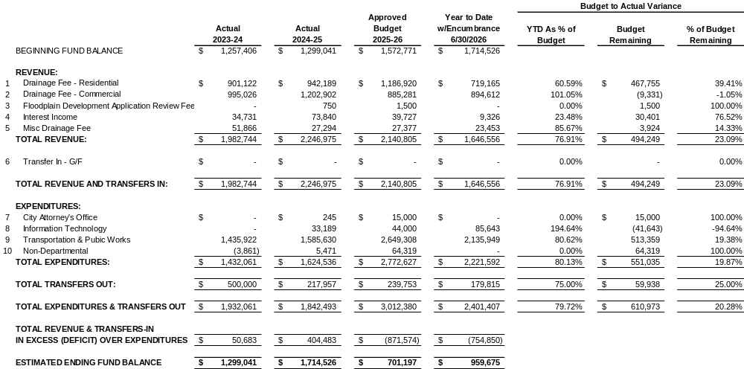
Storm Drainage Utility Fund

Slide 12
FY 2025-26 GENERAL FUND
COST CONTAINMENT MEASURES IMPLEMENTED

Slide 13
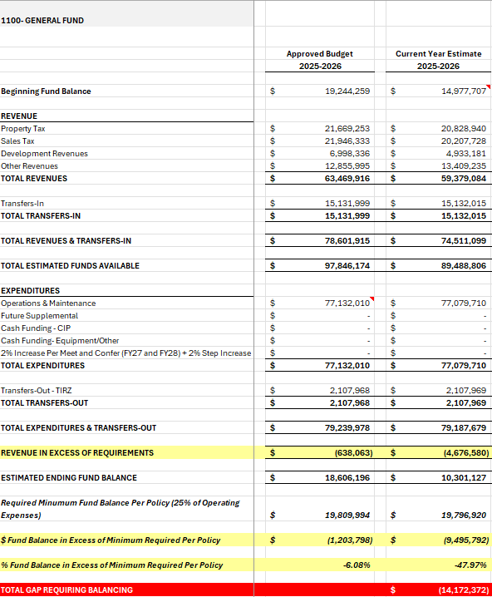
Current Year Estimates – General Fund
Revenues & Expenditures
Fiscal Year 2025-26

Slide 14
FY2025-26 COST CONTAINMENT MEASURES
Redundancy Based Position Eliminations
Positions on Temporary Freeze
Support Cost Containment
Purchase Order Purge

Slide 15
REDUNDANCY BASED POSITION ELIMINATIONS
GENERAL FUND
Eliminated Position | FY 2026 Savings
Chief Communications Officer | $35,828
Executive Director of Strategic Development | $57,736
Chief Development Officer | $51,823
Assistant Finance Director | $41,583
Deputy Parks and Recreation Director | $32,385
Business and Strategic Planning Manager | $23,368
Total Savings (6 FTEs): | $242,723

Slide 16
POSITIONS ON TEMPORARY FREEZE
GENERAL FUND
Frozen Position | FY 2026 Savings
Director, Animal Services | $82,988
Building Inspector | $45,334
Code Enforcement Officer | $38,377
Procurement Specialist | $18,303
Budget Analyst | $14,873
Human Resources Business Partner | $45,334
Assistant Director, Library Services | $72,304
Circulation Assistant- Part-Time (2) | $24,140
Parks Aquatic Maintenance Technician | $30,116
Senior Parks Technician | $12,323
Emergency Planner | $53,730
Records Specialist (2) | $70,731

Slide 17
POSITIONS ON TEMPORARY FREEZE
GENERAL FUND
Frozen Position | FY 2026 Savings
Engineering Technician | $41,783
Engineering Associate | $53,730
Street Technician (2) | $70,731
City Manager | $64,102
Assistant Parks Director | $26,410
Recreation Coordinator | $16,617
Director, Transportation and Public Works | $46,189
Recreation Divisional Manager | $18,770
Total Savings (23 FTEs) | $846,782

Slide 18
GENERAL FUND COST CONTAINMENT SUMMARY
Redundancy Based Position Eliminations: $242,723
Positions on Temporary Freeze: $846,782
Support Cost Containment: $3,434,215
Purchase Order (PO) Purge: $671,252
FY 2025-26 GENERAL FUND COST CONTAINMENT SAVINGS: $5,195,972

Slide 19
QUESTIONS?

