Slide 1
Report to City Council:
May 2026 Monthly Financial Update
City Council Meeting – June 16, 2026

Slide 2
Presentation Outline
Purpose of Monthly Financial Briefing
How Monthly Financial Briefings Help Council
General Fund Summary
Water Utility Fund Summary
Wastewater Utility Fund Summary
Storm Drainage Utility Fund Summary

Slide 3
Purpose of Monthly Financial Briefing
  The City of Kyle is committed to maintaining transparency, accountability, and proactive
  financial stewardship.
  Monthly financial reporting provides City Council with timely information
  regarding the City's financial position and budget performance throughout the fiscal year.

Slide 4
Monthly Financial Briefings Help Council...
  Monitor Financial Performance by comparing actual revenues and expenditures to the adopted budget throughout the year.
  Identify Emerging Trends Early to detect revenue shortfalls, expenditure pressures, or operational changes before they become significant financial challenges.
  Support Informed Decision-Making by providing current financial information to assist with policy discussions, budget amendments, and strategic priorities.
  Enhance Fiscal Transparency by providing consistent, routine reporting on the City's major operating funds and overall financial condition.
  Evaluate Fund Balance Health through ongoing monitoring of reserves and projected year-end financial positions to ensure long-term fiscal sustainability.
  Improve Financial Accountability by promoting regular review of departmental spending and revenue collection activity against approved budgets.
  Support Long-Term Planning by identifying trends that may impact future budgets, service levels, and financial forecasts.
  Ensure Compliance with Financial Policies by monitoring progress toward adopted financial targets, reserve policies, and budgetary controls.

Slide 5
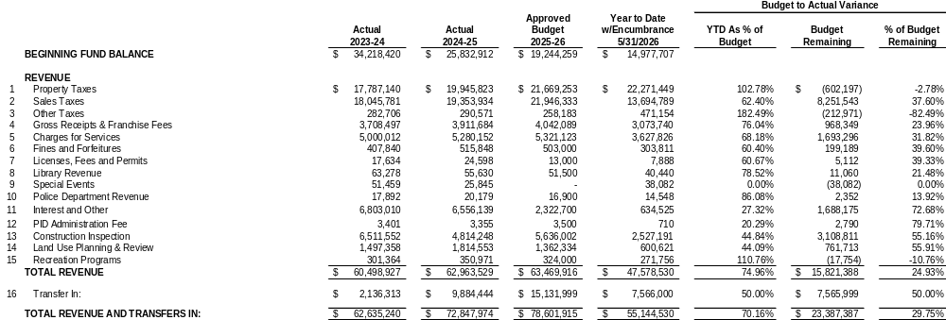
General Fund Summary

Slide 6
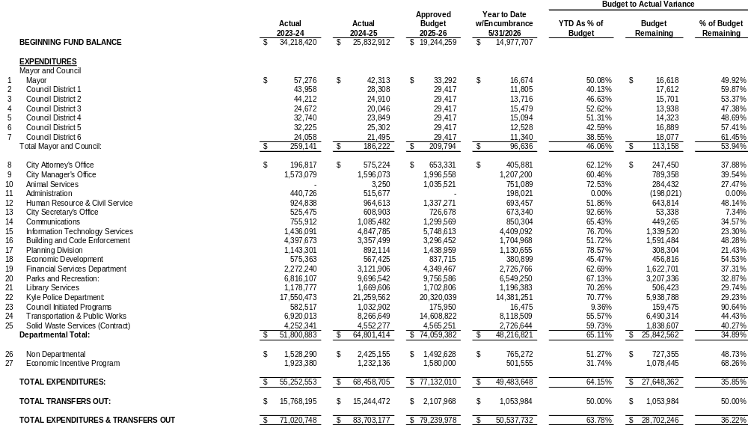
General Fund Summary

Slide 7
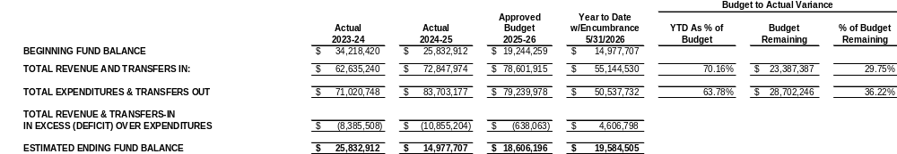
General Fund Summary

Slide 8
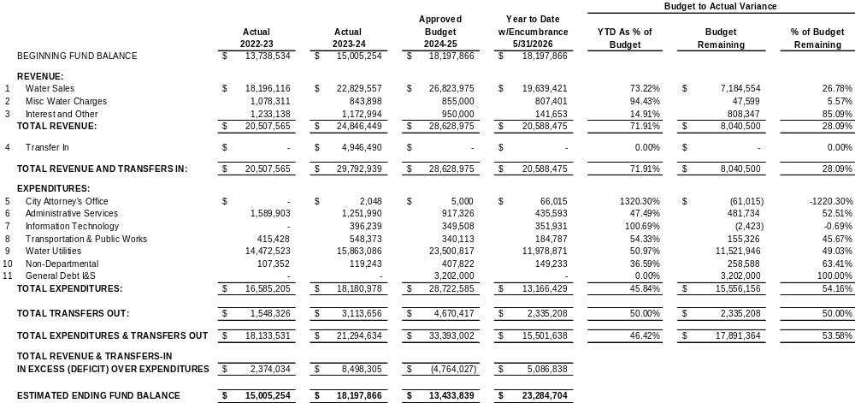
Water Utility Fund Summary

Slide 9
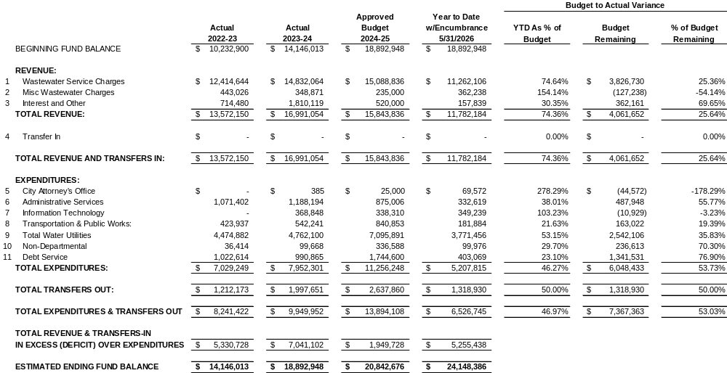
Wastewater Utility Fund Summary

Slide 10
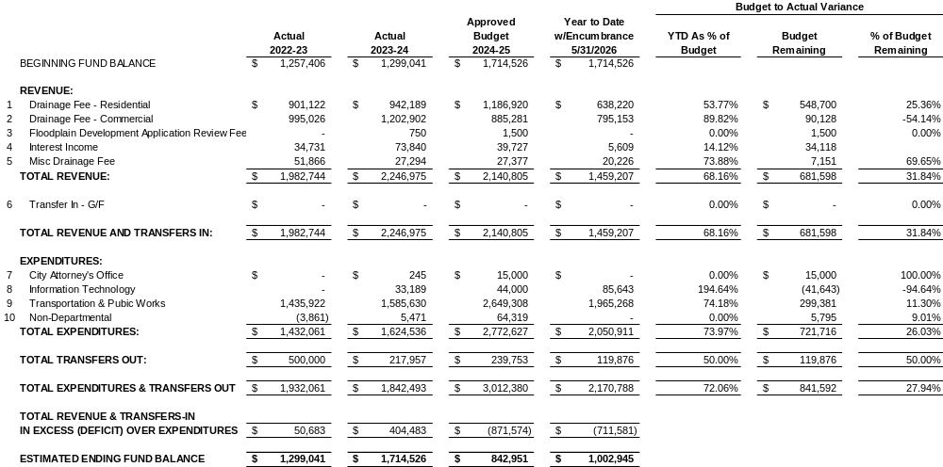
Storm Drainage Utility Fund

Slide 11
QUESTIONS?

