Slide 1


Slide 2
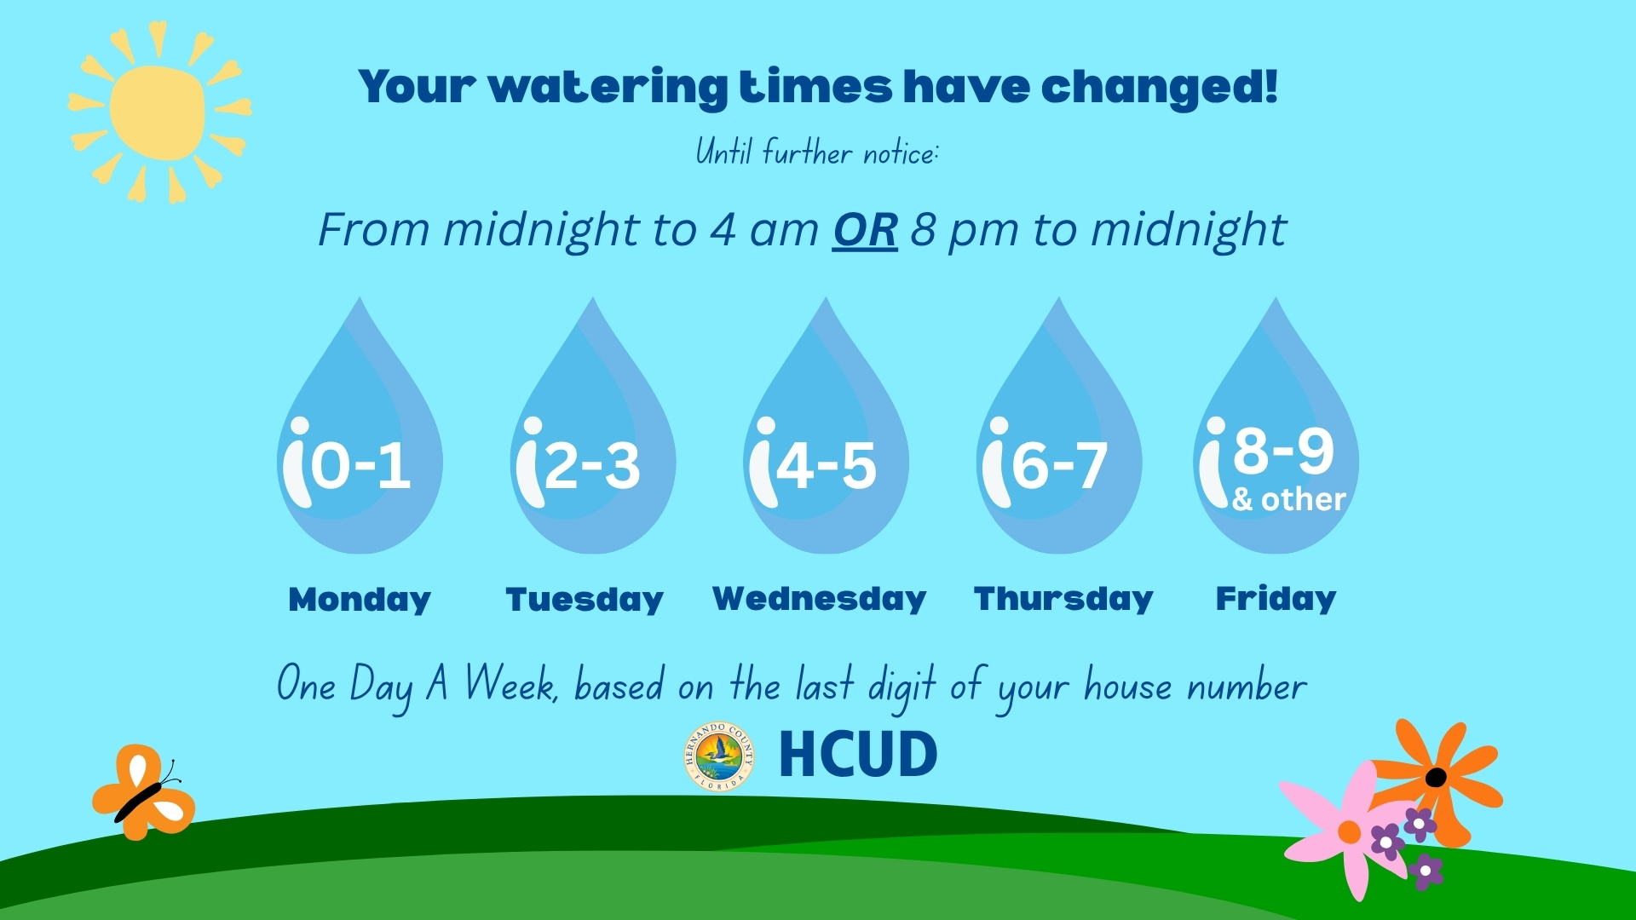

Slide 3

Disaster Preparedness
March 26, 2026

Slide 4
Agenda
What is Emergency Management?
What Hazards are we prone to?
How to stay informed
Disaster Kit
Sheltering

Slide 5
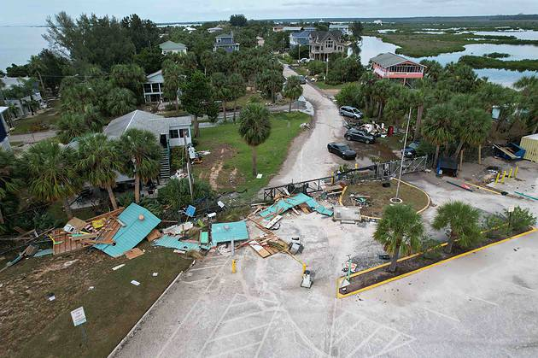

What hazards are we prone to?
Severe Thunderstorms
Lightning
Flooding
Tornados
Hurricanes
Wildfires
Sinkholes

Slide 6
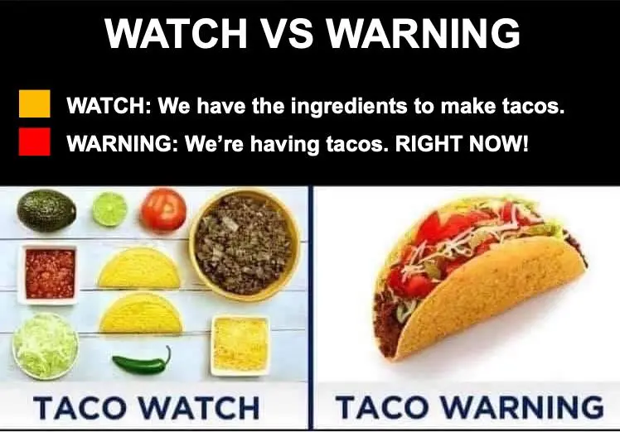
What is the difference between a “watch” and a “warning” ?
Watch: Possibility of a threat!
Warning: A threat is imminent and going to happen!

Slide 7
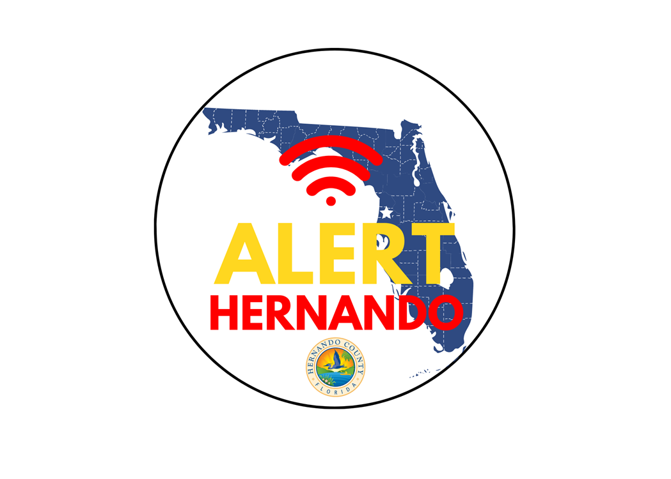





How do we get notified?
Alert Hernando
  “member.everbridge.net/453003085614870/login”
Weather Radios
Local News
Hernando County Emergency Management Social Media
  Facebook;
  Instagram;
  X (Formerly Twitter)
  County Website

Slide 8
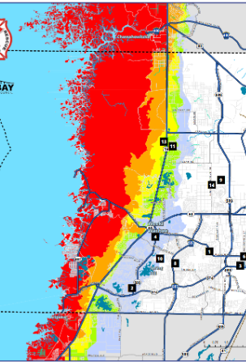

Find Your Evacuation Zone
Floridadisaster.maps.arcgis.com
Some situations might call for an immediate evacuation, while other instances might allow for multiple days.
Make a plan!

Slide 9
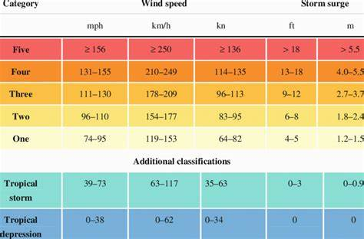
Preparing for an emergency
Know your evacuation zones
Have a disaster kit for reach member in your family
Have a disaster kit for any pets that you have
Know your evacuation routes

Slide 10
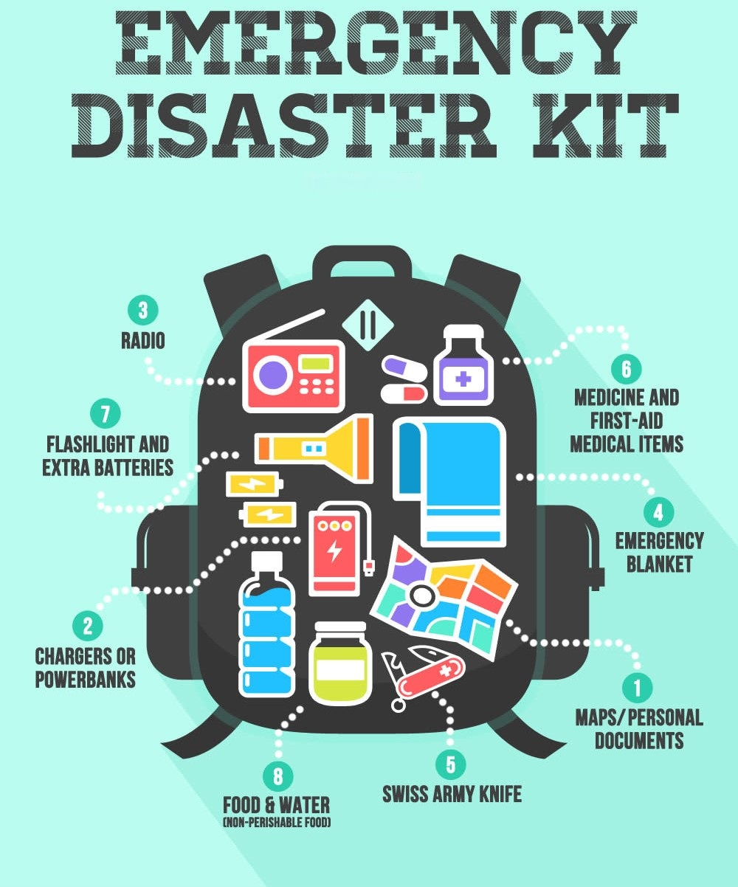
What is in a disaster kit?
  Water- 1 gallon for each person for 3 to 7 days
  Food- enough for at least 3 to 7 days; non-perishable packaged or canned food and beverages, snack foods, juices
  Non-electric can opener, paper plates, plastic utensils, plastic cups
  Grill, cooking tools, fuel, charcoal
  Blankets, pillows, sleeping bags, etc.
  Clothing- seasonal/rain gear/sturdy shoes or boots
  First Aid Kit, prescriptions, medications, sunscreen, aloe and bug spray
  Special items for babies, elders, persons with disabilities
  Toiletries- hygiene items and sanitation wipes/baby wipes
  Flashlights and batteries- DO NOT USE Candles
  Extra house and car keys, office keys, name badges

Slide 11
Additional Disaster Kit Items
  Cash- banks/ATMs may not be available after a storm
  Radio- battery operated or hand cranked radio, NOAA Weather radio
  Books and games
  Important documents
  Document all valuables
  Tools- keep a set with you
  Vehicle- keep your vehicle filled with fuel
  Pet care items- pet food and water, proper identification, medical records, a carrier cag, muzzle and leash, medications
  List of important telephone numbers- including your county EM Office, evacuation sites, doctors, bank, area schools, veterinarian, etc.

Slide 12
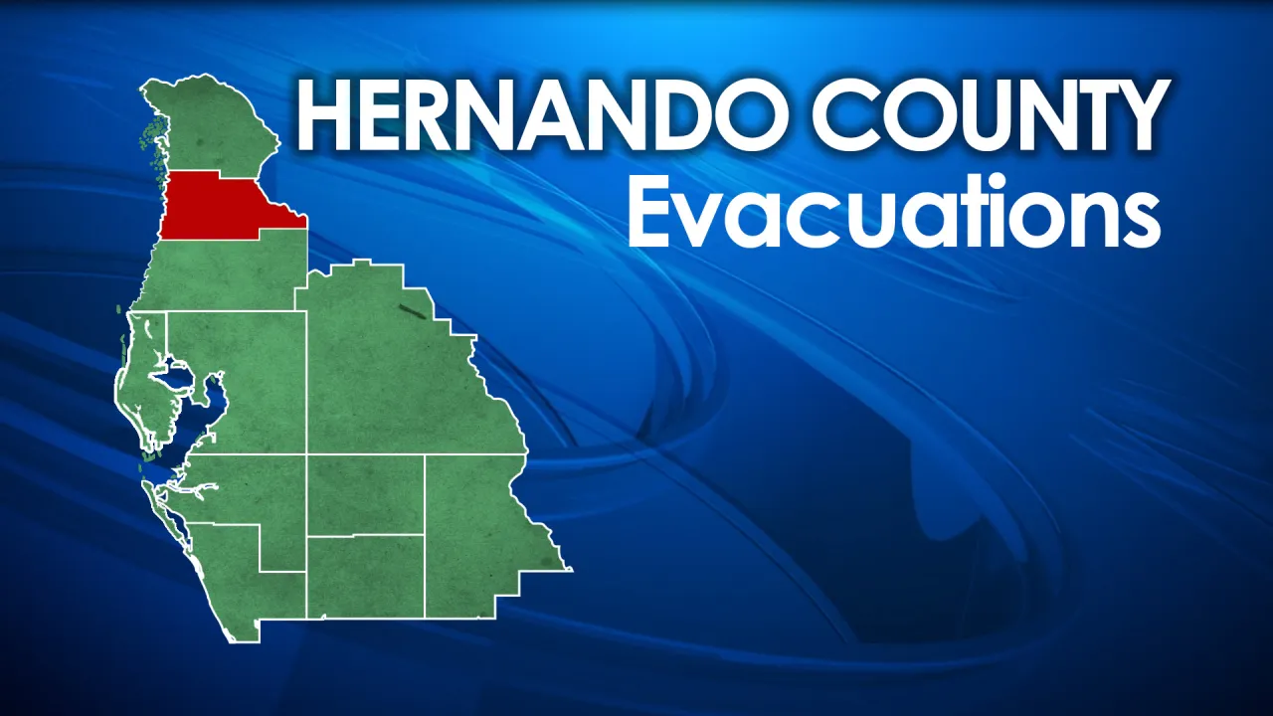
Sheltering
Hurricane shelters should be used as a last resort
Evacuate, if possible, seek shelter if you cannot
Open shelters are announced on Hernando County PIO, social media and news outlets
Some shelters are equipped for special needs clients such as those who require accommodations

Slide 13
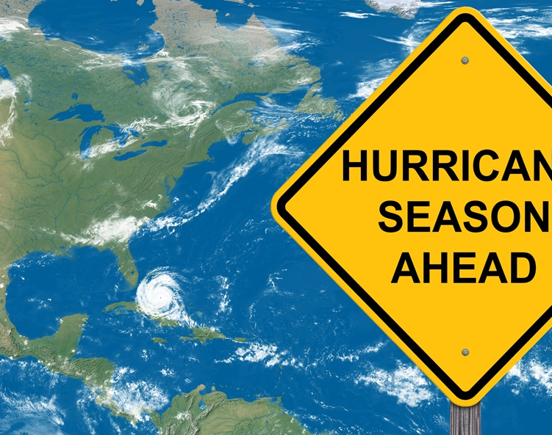
Trivia
What is the start date for Hurricane Season?

Slide 14
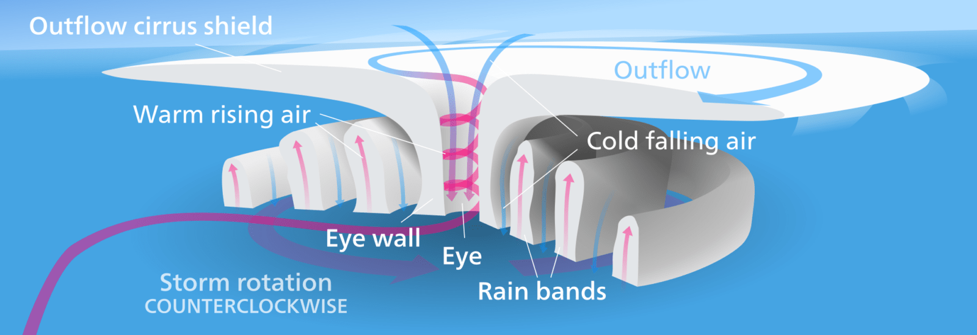
Trivia
What is the minimum windspeed of a tropical storm?

Slide 15
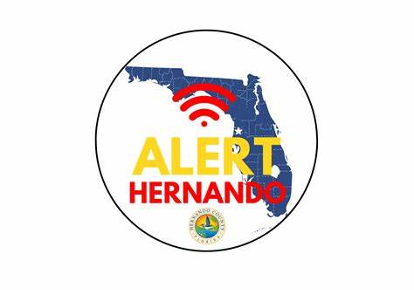
Trivia
Where can you find the information on your evacuation zone?

Slide 16

Questions?
352-754-4083
18900 Cortez Blvd, Brooksville, FL 34601
www.hernandocounty.us/em
Contact Hernando County Emergency Management

Slide 17


Slide 18


