Slide 1


Slide 2
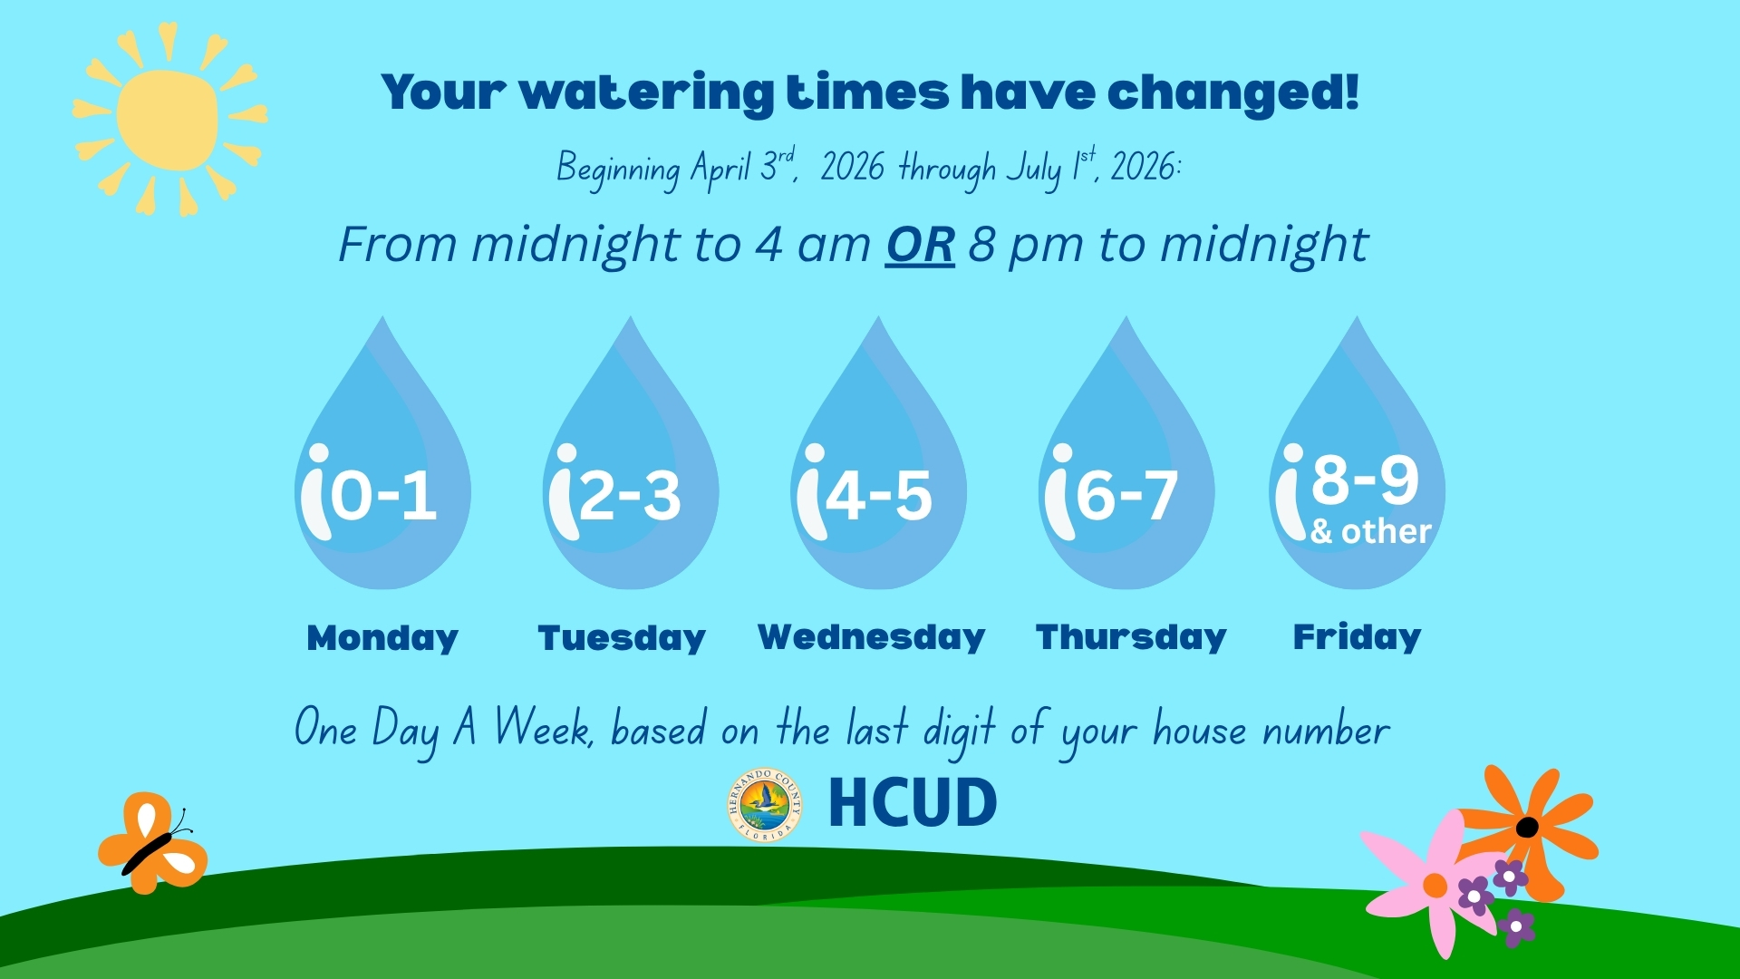

Slide 3
Rainfall Signage Pilot Project
Hernando County Water Awareness
June 17, 2027
Robin Grantham
Lead Communications Strategist

Slide 4
Agenda
Background: Initial Study and Phase I
Planning Phase II
Project Goals and Objectives
Survey Data Collection & Findings
Water Use Analysis & Findings
Future Project Planning

Slide 5
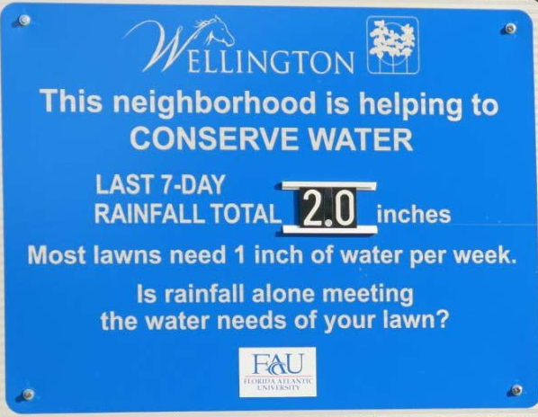
Background – Beyond Water Restrictions Study
Florida Atlantic University, Felicia D. Survis
2016 study in Wellington, FL
Awareness of rainfall and lawn water needs
Challenges to project expansion:
      Staff time to physically update rainfall amount
      Permitting requirements

Slide 6
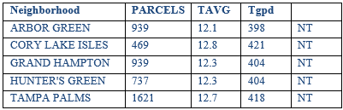
Background – Project Planning
Concerns Addressed:
      Staff time: Cellular connectivity to remotely update data
      HOA electrical costs: Solar power
      Permitting concerns: No permitting required if installed within 100’ from low-voltage tie-in on HOA property
      Community Selection Considerations
      All homes use potable water for irrigation
      Residents control their irrigation controllers
      High water-use community (greater than 300 gpd)
      Minimal entrances and exits

Slide 7
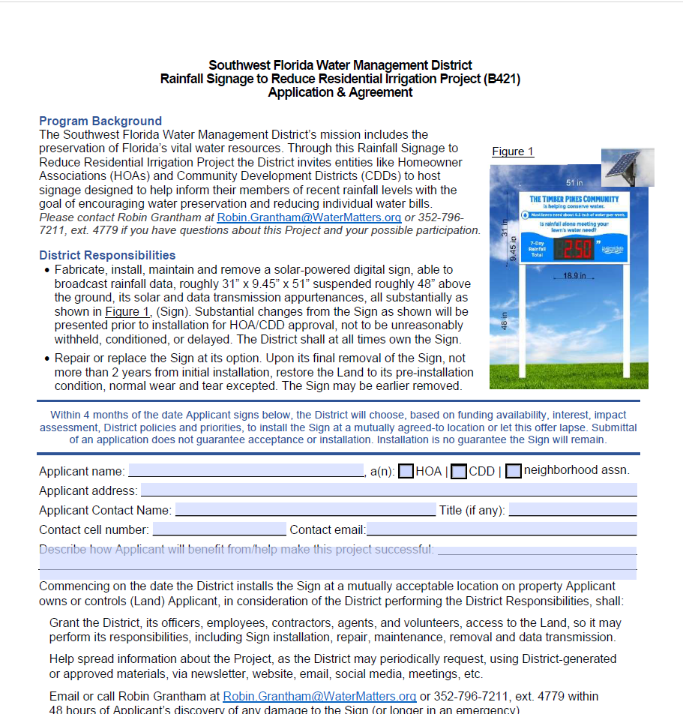
Background – Project Planning
Community Buy-In: HOA/CDD project presentations
      HOA/CDD project presentations
      Agreement and application
      Sign Content and Fabrication
      Text/Content pretesting
      Community Pantone colors
      Location
        Full sun
        Safety and visibility concerns
        “Call Before You dig”

Slide 8
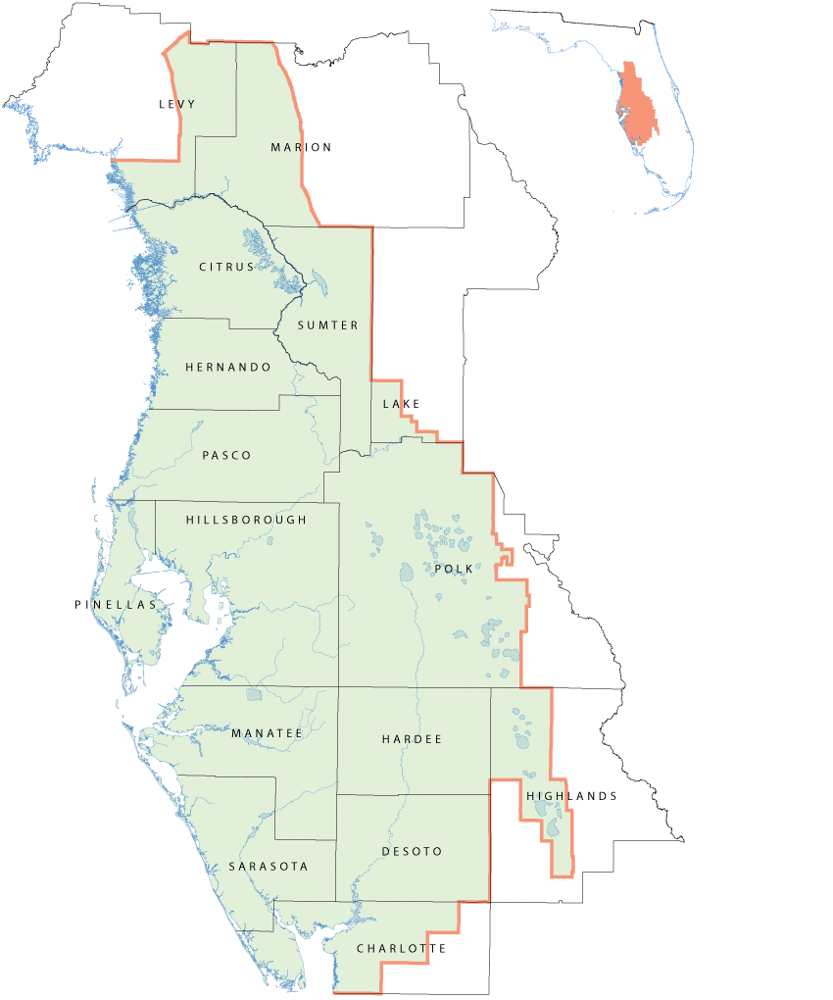
Background – Pilot Phase I
Hunter’s Green – Tampa 2023
UF partnership
Goal: Determine the effect that educating residents about weekly rainfall and turf water needs has on reducing residential water use

Slide 9
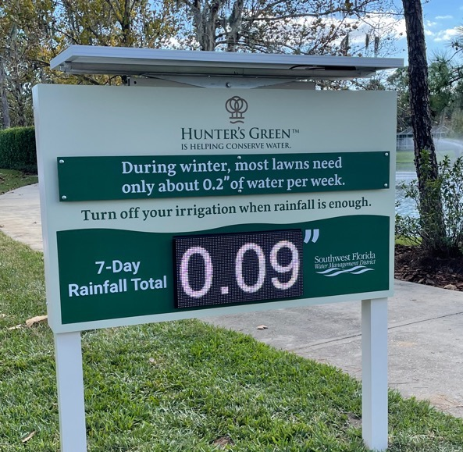
Background – Pilot Phase I Findings
Survey Findings:
      No changes to self-reported conservation practice or knowledge
      Residents maintained generally positive perceptions of adjusting irrigation based on recent local rainfall
      Rainfall sign became primary source of rainfall data
      Awareness of lawn water needs and consideration of rainfall to adjust irrigation both increased
    Water Use Findings
      Consumption decrease was not significant to suggest influence of sign on irrigation water use

Slide 10
Background – Pilot Phase I Lessons Learned
White display uses too much digital data
Sign should be installed before rainy season
Battery backup needed
Solar panels should be adjusted seasonally
Educational components are needed
Sign not reflective of weekly rainfall totals

Slide 11
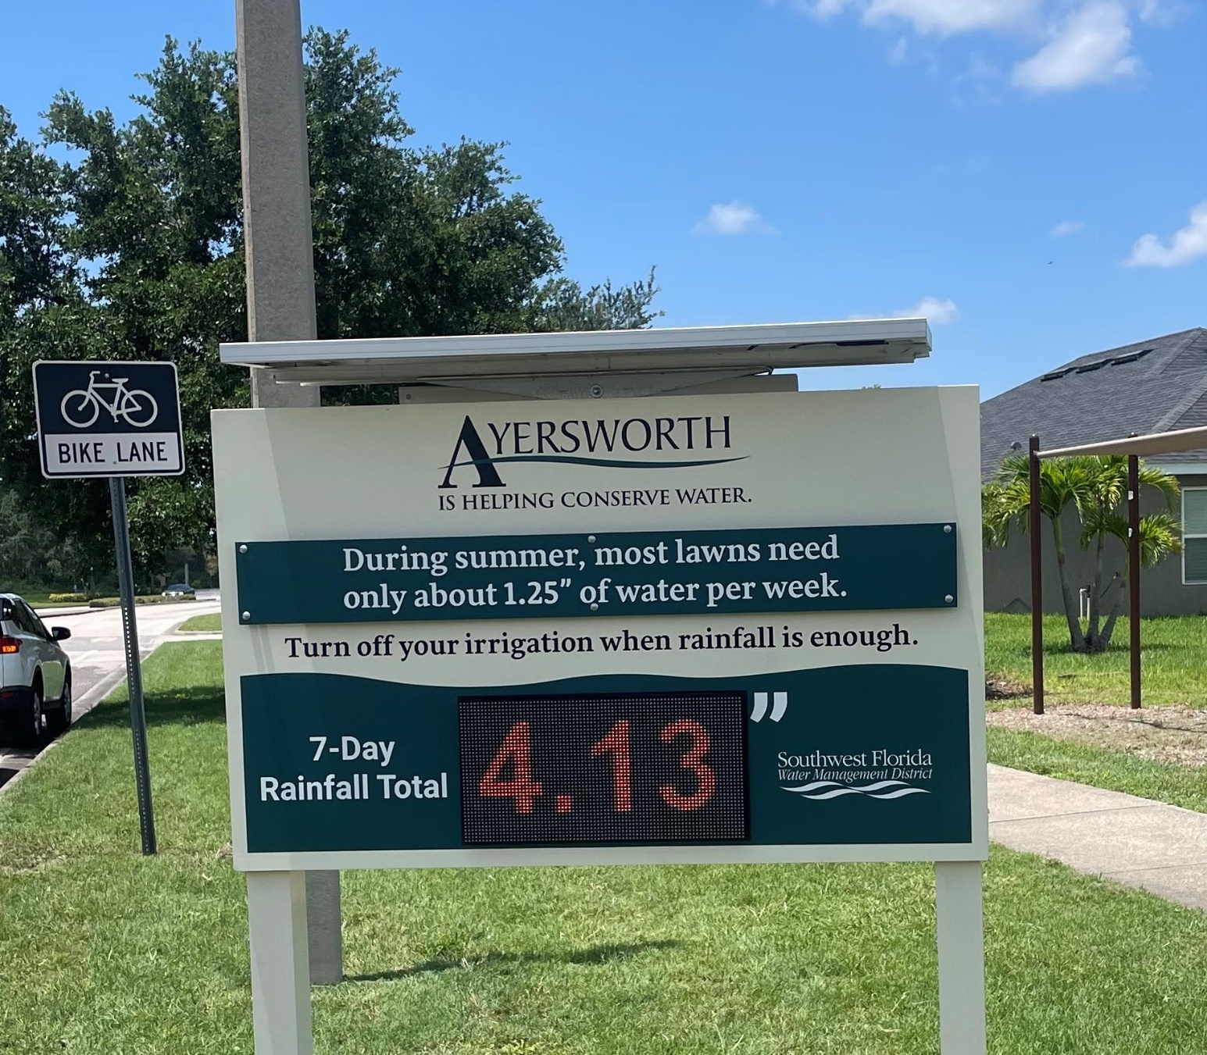
Phase II: Ayersworth Glen – Wimauma, FL
Goal: To evaluate the effect that education about weekly rainfall and turf water needs has on reducing residential water use.
Objectives:
  To increase by 10% the number of residents within the experiment community who self-report reducing the amount of irrigation water they apply based on weekly rainfall (survey).
  To reduce the experiment community’s average annual water consumption by 10% (survey).
  To obtain a project cost below $4 per one thousand gallons of water saved by the experiment community.

Slide 12
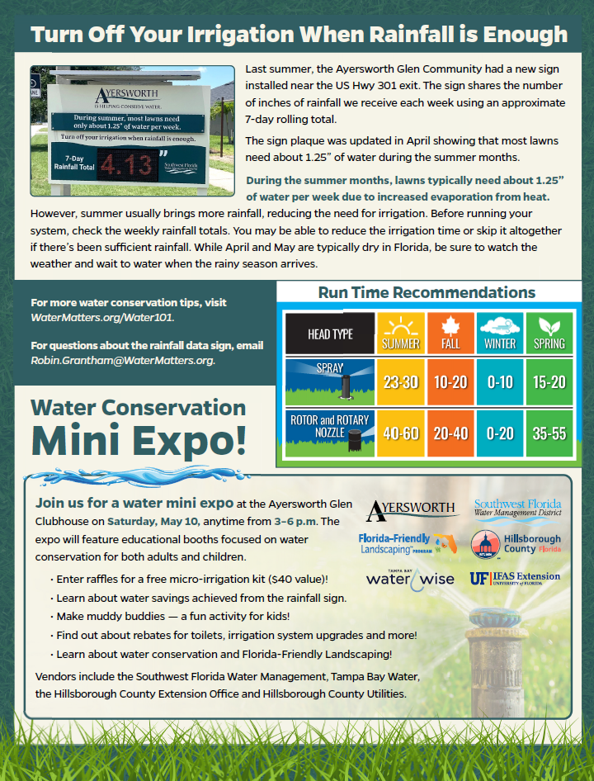
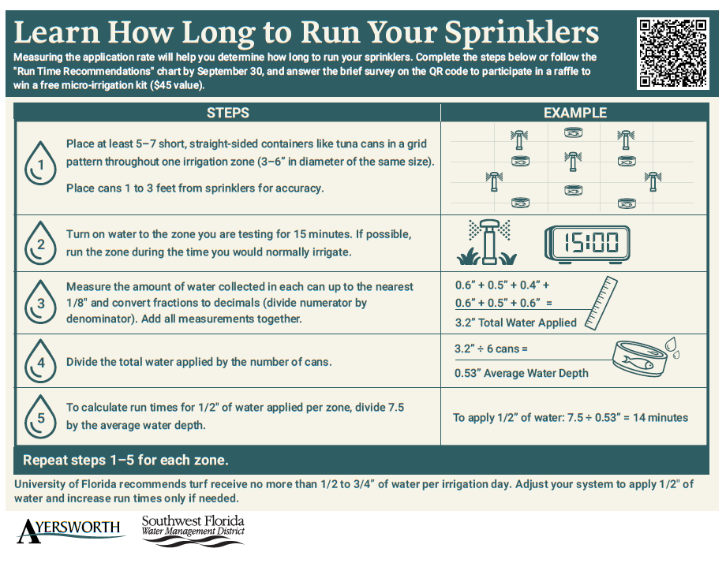
Project Planning Phase II
Address Lessons Learned from Phase I
  Increased battery size to allow for white or multi-color display content.
  Installed in July during the rainy season.
  Installed within 100’ of low-voltage power supply for battery backup if needed.
  Adjusted solar panel angles with the time change.
  Updated daily with weekly rolling rainfall totals.
  Incorporated quarterly newsletters and a community expo event.

Slide 13
Survey Data Collection
Experiment population of approximately 1,700 households.
Pre-/Post-surveys distributed via mail.
Surveys could be completed using QR code link or hardcopy with pre-paid envelope.
Pre-survey was conducted in June 2024 with 223 completed surveys (220 after disqualifiers removed).
Post-survey was conducted August 2025 with 62 completed surveys (61 after disqualifiers removed).
Those who responded that they did not have or did not know if they had an inground irrigation system were disqualified from completing the survey.

Slide 14
Disqualifier: Do you have an automatic sprinkler or irrigation system at your home?

Slide 15
Reduce how often I irrigate during the shorter and cooler months of fall and winter.
5% increase (+5 percentage points)

Slide 16
Adjust how long and how often I irrigated based on how much water is applied to run my sprinklers.
7% increase (+6 percentage points)

Slide 17
Reduce the amount of irrigation water I apply based on rain gauge or local rainfall reported.
6% increase (+5 percentage points)

Slide 18
There are benefits to local water resources when I adjust my irrigation practices based on local rainfall.
6% increase (+5 percentage points)

Slide 19
Adjusting my irrigation practices based on local rainfall fits within my community’s landscape expectations.
12% increase (+8 percentage points)

Slide 20
I would adjust my irrigation practices based on recent rainfall if others in my community did it too.
27% increase (+7 percentage points)

Slide 21
It would be difficult for me to adjust my irrigation practices based on rainfall received.
43% increase (+6 percentage points)

Slide 22
I know how to turn my irrigation controller on or off to adjust for recent rainfall.
4% decrease (-4 percentage points)

Slide 23
Compared to a year ago, before the Highland’s Community rainfall signage project, how would you say your awareness of your lawn’s watering needs has changed?
49% increase; 50% no change

Slide 24
Compared to a year ago, before the Highland’s Community rainfall signage project, how has your considerations of local rainfall impacted how you adjust your irrigation controller?
34% increase more often; 60% no change; 8% less often

Slide 25
Post-Project Key Survey Findings
Half of respondents (49%) reported an increase in awareness of their lawns’ water needs compared to before sign installation.
One-third of respondents (34%) reported adjusting their irrigation controller slightly more often to much more often compared to before sign installation.
Increase of 8% in residents who believe adjusting their irrigation practices based on local rainfall fits within their community’s landscape expectations.

Slide 26
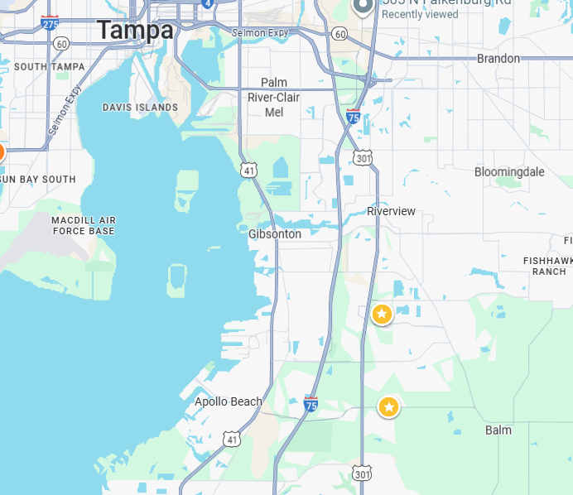
Water Use Analysis
Water Use Variables
  Rainfall
  Economy
  Local water restrictions
  Comparison Community: Panther Trace
  Geographic location
  Average lot sizes – 4,500 to 6,500 square feet (0.10-0.15 acres)
  Average home size – Panther Trace slightly larger average of 2,150 ft² and Ayersworth Glen average of 1,900 ft² (250 ft² difference)

Slide 27
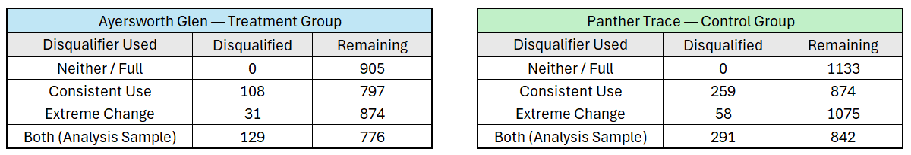
Water Use Analysis
Hillsborough County Utilities provided water use data for Ayersworth Glen and Panther Trace for the following time periods:
  One year prior to sign installation (July 2023-July 2024)
  One-year post-sign installation (July 2024-July 2025)
Disqualifiers
  Consistent Use – Households with monthly water use less than 10 gallons per household per day.
  Extreme Change – Households with a percentage change in water use greater than 100% (doubled).

Slide 28
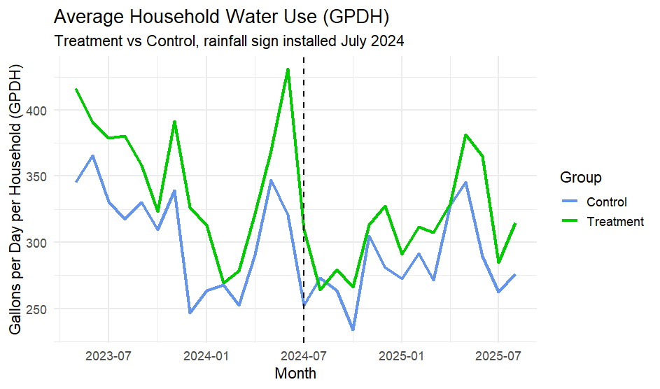
Water Use Analysis Findings
Average savings per home per day: 18 gallons
Total Ayersworth Glen savings per day: 6,617 gallons
Total Ayersworth Glen savings per year: 5,988,702 gallons
Cost per thousand gallons saved:
  Refurbished sign with educational mailouts: $1.51
  New sign with educational mailouts: $2.65

Slide 29
Future Project Planning
Secure purchase of additional sign.
Develop partnership program with local utility to implement project management and education.
Robin.Grantham@WaterMatters.org
WaterMatters.org/SocialResearch

Slide 30
Intermission

Slide 31
Water 101 for
Homeowners
Katherine Squitieri
Lead Communications Coordinator

Slide 32
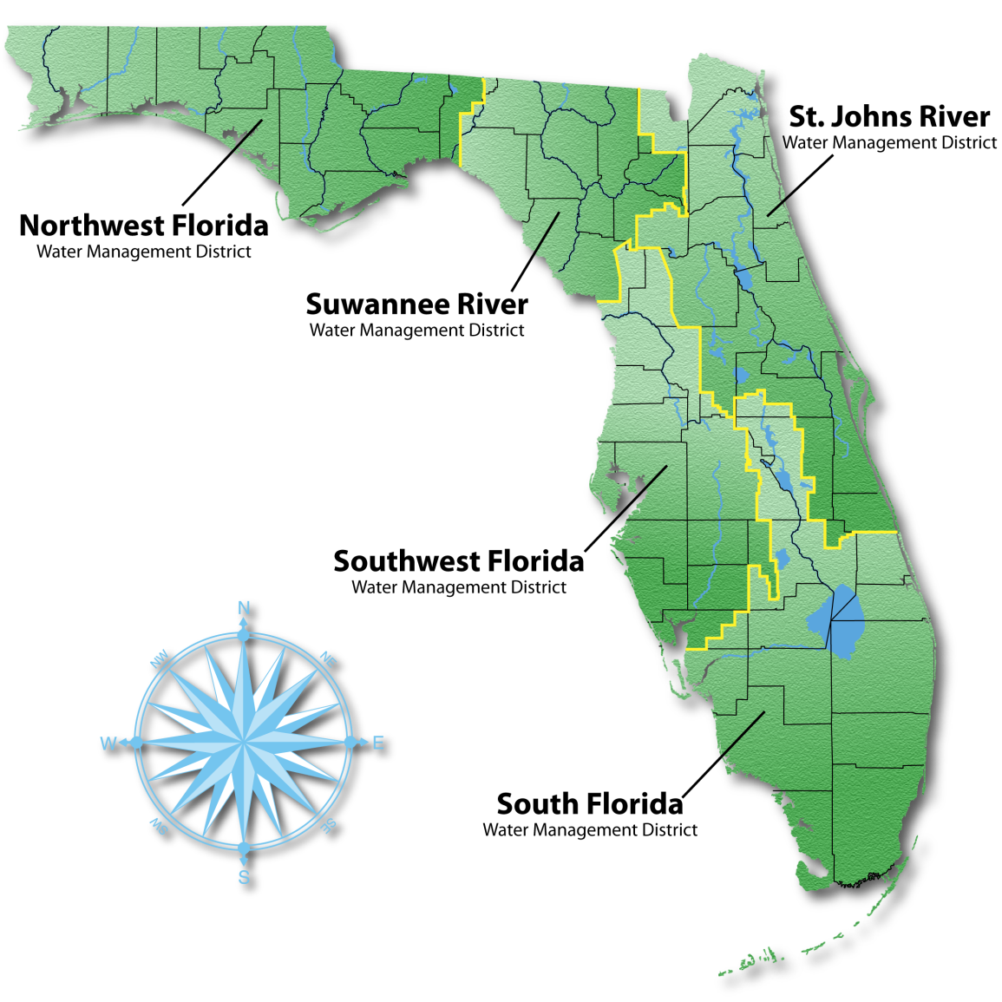
Who We Are
10,000 square miles
Covers all or part of 16 counties
Nearly 6 million people
Notes:
The District is in one of five water management district’s throughout Florida directed by state law to protect and preserve water resources within our boundary.
We cover all or part of 16 counties and serve nearly 6 million people.
The boundaries of the District extend north into Levy County, south into Charlotte County and inland into Polk and Highlands counties.

Slide 33
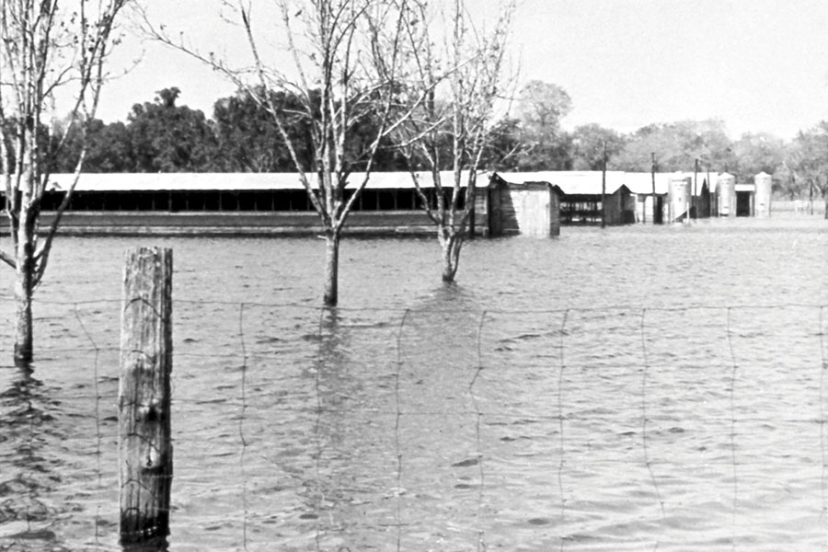
How We Got Here
  Hurricane Donna (1960)
District formed as a flood control district (1961)
In 1972, the Legislature created the current structure with expanded duties (Chapter 373 F.S. Water Resources Act)
Notes:
In 1960, Hurricane Donna caused severe flooding in this region. Following that, the District was established to operate several federal flood protection projects.
Then in 1972, the Legislature added more water management districts and expanded their duties. The Legislature also gave us the ability to collect ad valorem taxes.

Slide 34
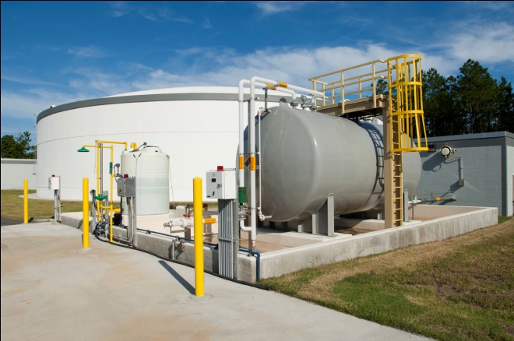
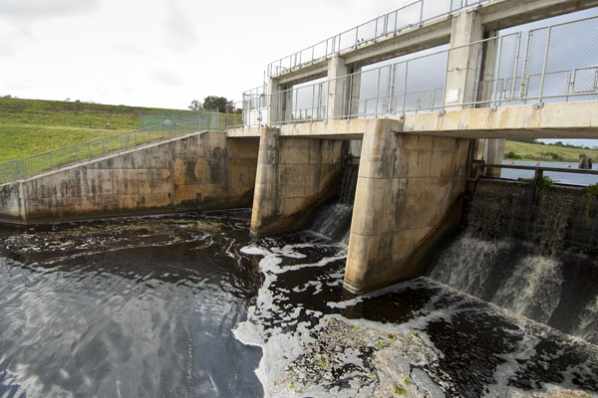
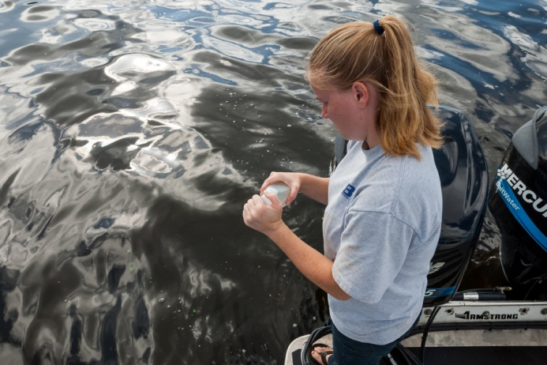
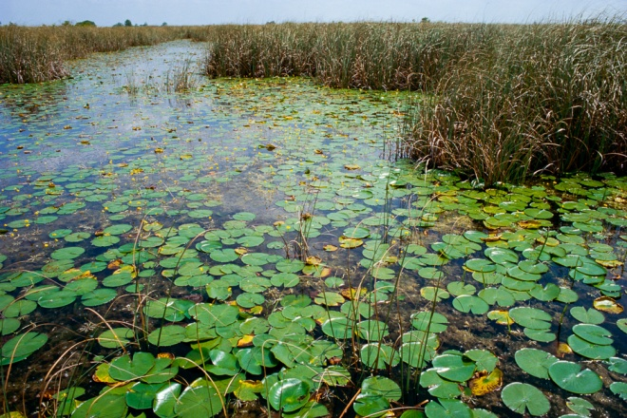
Core Mission
Water Supply
Flood Protection
Water Quality
Natural Systems
Notes:
Today, the District’s mission is to protect water resources, minimize flood risks, and ensure the public’s water needs are met.
Within that mission, we have four core areas of responsibility:
Ensuring there are adequate water supplies for both people and the environment. We are not a water utility but are a regulatory agency and anyone wanting to pump large quantities of water, such as a utility, must receive a permit from the District. Other examples include implementing water restrictions when needed, funding alternative water supplies, promoting water conservation and more.
Another area of responsibility is flood protection. Examples include regulating environmental resource permits to ensure adequate stormwater systems are included in new development, working with local governments to implement projects that reduce regional flooding, and managing flood control structures capable of moving large rates of water such as the Tampa Bypass Canal.
A third area of responsibility is water quality. The District monitors the water quality of groundwater and surface water bodies and helps fund projects that help to protect and improve water quality.
Protecting local natural systems is our fourth area of responsibility. One example is through environmental resource permitting to protect natural systems. Another example is the thousands of acres of conservation land the District owns and manages. The region’s lands and waters are forever linked by Florida’s natural water cycles.

Slide 35
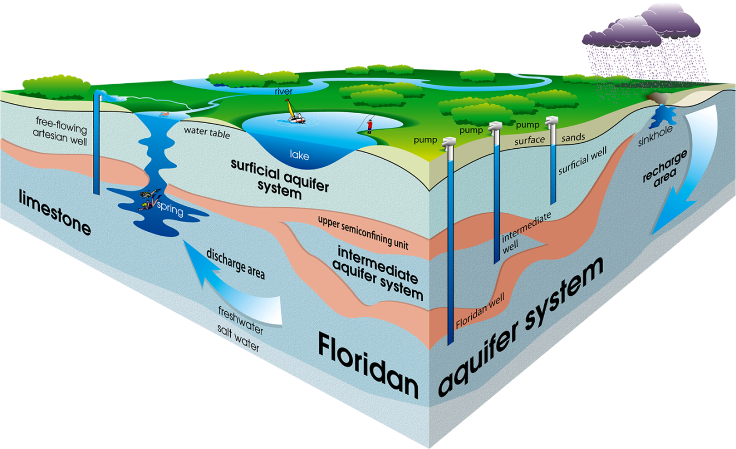
Water Supply
About 80 percent of our water comes
from the Floridan aquifer system
Notes:
In Florida, water is a resource that belongs to all residents. However, water is a limited resource.
Rain provides the majority of Florida’s water supply with an average rainfall in our District of 53 inches per year. We can’t control the amount of rain we receive.
Much of this rainwater is lost to evaporation and transpiration. In fact, only 2 to 40 percent of average rainfall recharges the aquifer depending on the particular area and its geology and soils.
The water that soaks into the ground is referred to as groundwater.
Most of this groundwater comes from the Floridan aquifer system, which supplies about 80% of the water we use in the region.

Slide 36
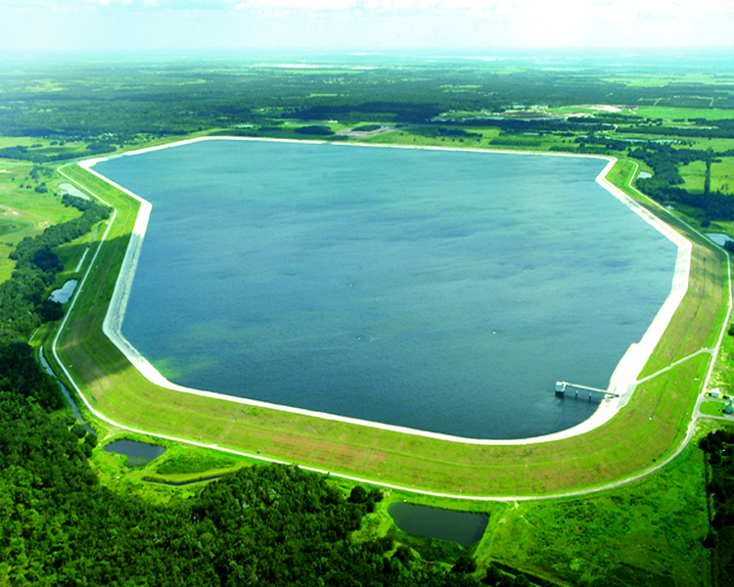
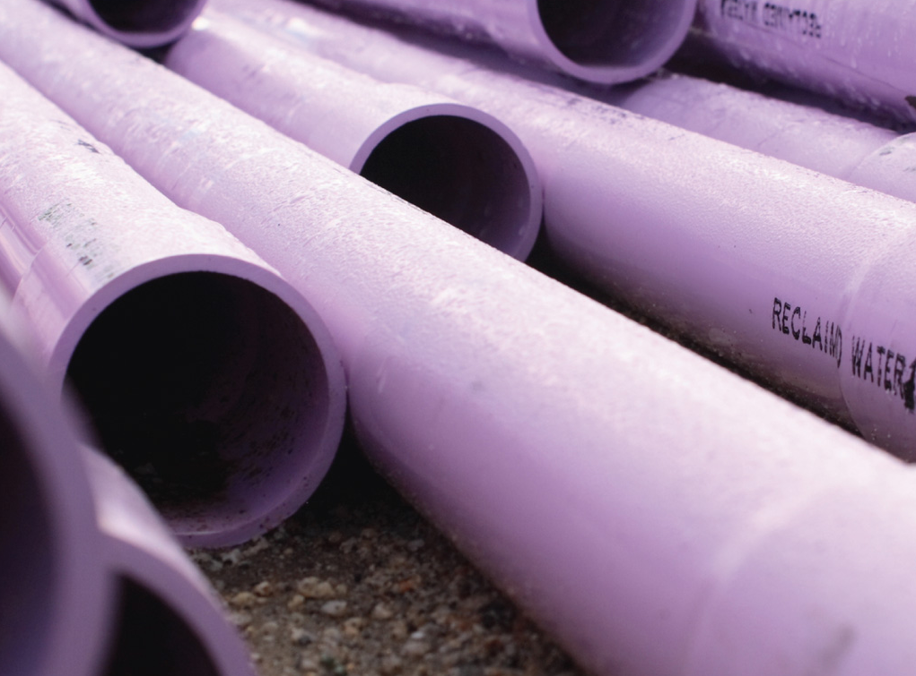
Alternative Water Supplies
Reclaimed Water
Surface Water
Reservoirs
Desalination
Aquifer Storage and
Recovery
Notes:
The District works with local governments and regional water supply authorities to investigate, develop and implement a wide range of alternative water sources.
Reclaimed water is highly treated wastewater that can be used for irrigation and other uses to extend our freshwater supplies.
The District is a national leader in water reuse.

Slide 37
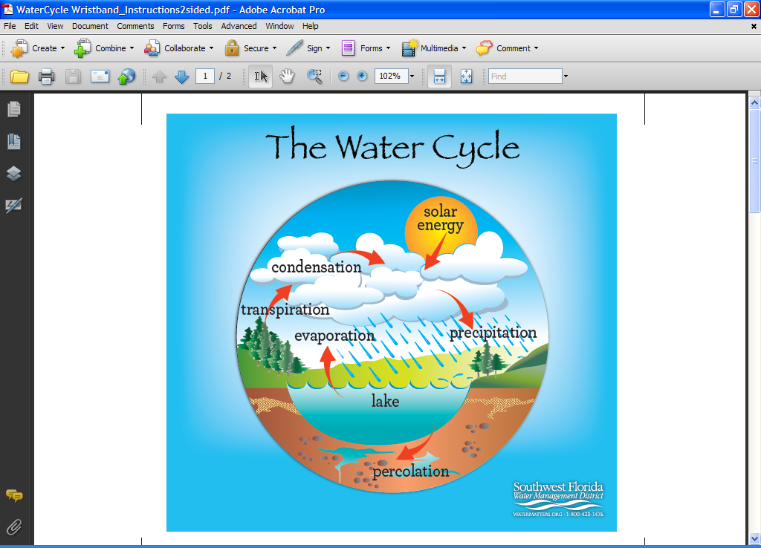
Rainfalls Role in Water Supply
Current 12-month rainfall: 34.74 inches (very dry)
Rainy Season: 60% of rainfall occurs June – Sept.
Notes:
Current 12-month rainfall (as of June 15)
District cumulative 12-month rainfall is 35 inches, with the cumulative average being 53 inches.
In Northern region, current 12-month rainfall is 37 inches, with the cumulative average being 54 inches.
In Hernando County, current 12-month rainfall is 38 inches, with cumulative average being 55 inches.
The District’s Modified Phase III one-day-per-week water shortage restrictions are in effect April 3, 2026, through July 1, 2026.
The rainfall deficit for April was 11.4 inches.

Slide 38
Why Conserve Water?
Water conservation is a key link between balancing current and future water needs.
Notes:
Developing alternative water supplies is costly, and there’s more than 1,000 people moving to Florida daily.
Water conservation is the link between balancing current and future water needs.
The choices you make as a homeowner or community, from the plants in your landscape to how you water your lawn, can make a big difference on your overall water use, and it’s important to understand your personal impact.

Slide 39
Saving Water
Indoors and Outdoors

Slide 40
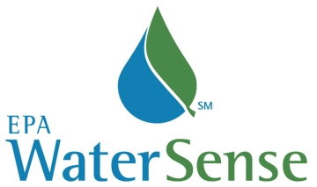
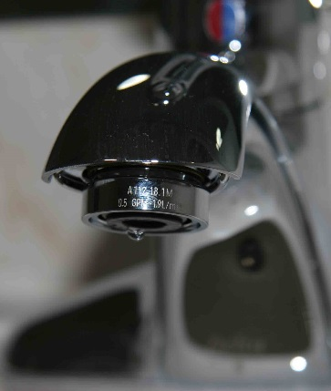
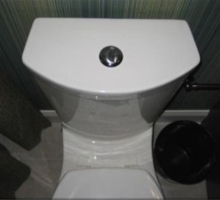
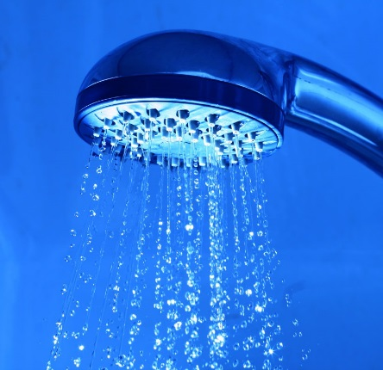
Save Water Indoors
Notes:
For your indoor fixtures such as faucets, toilets and showerheads, look for EPA’s WaterSense label. Products with this label have been tested to meet high quality performance while using less water than traditional products.

Slide 41

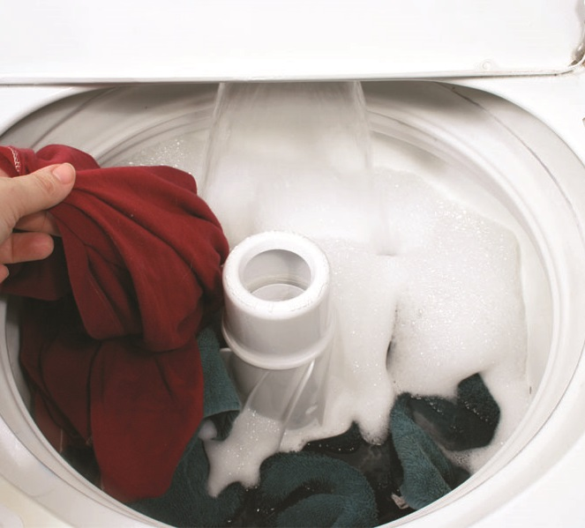
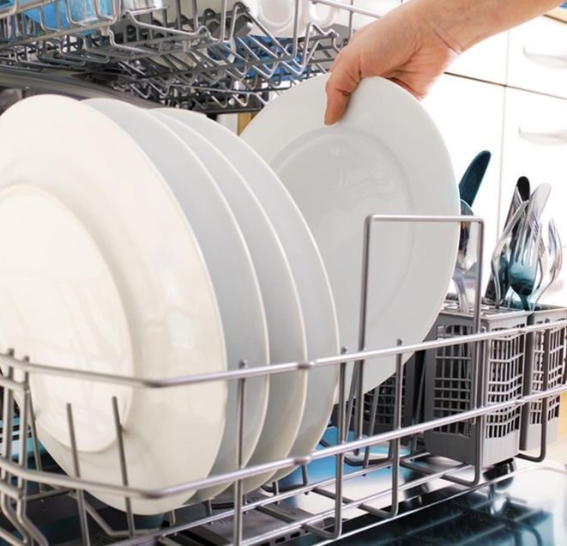
Save Water Indoors
Notes:
Similar to the WaterSense label, appliances like clothes washers and dishwashers with the EPA’s EnergyStar label also use less water with proven efficiency and quality.

Slide 42
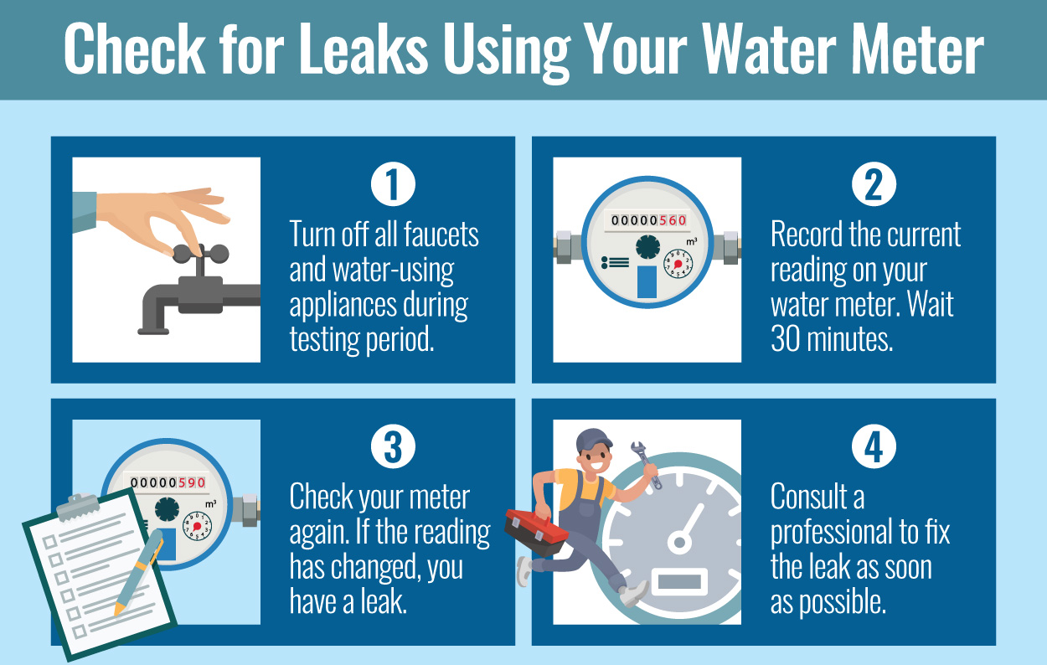
Save Water Indoors – Check for Leaks
Notes:
Fixing leaks and installing a few inexpensive water-saving devices in your home could save over 20,000 gallons of water each year. Common indoor leaks include toilets, faucets, showerheads, appliances and piping.
One way to easily see if you have a leak is to check your water meter.
To do this, turn off all the faucets and water-using appliances in and out of your home. Make sure no one uses water during the testing period.
Go to your water meter and record the current reading. Wait 30-minutes. Again, do not use water.
Go back to the meter and record the reading again. If the reading has changed, you have a leak.

Slide 43
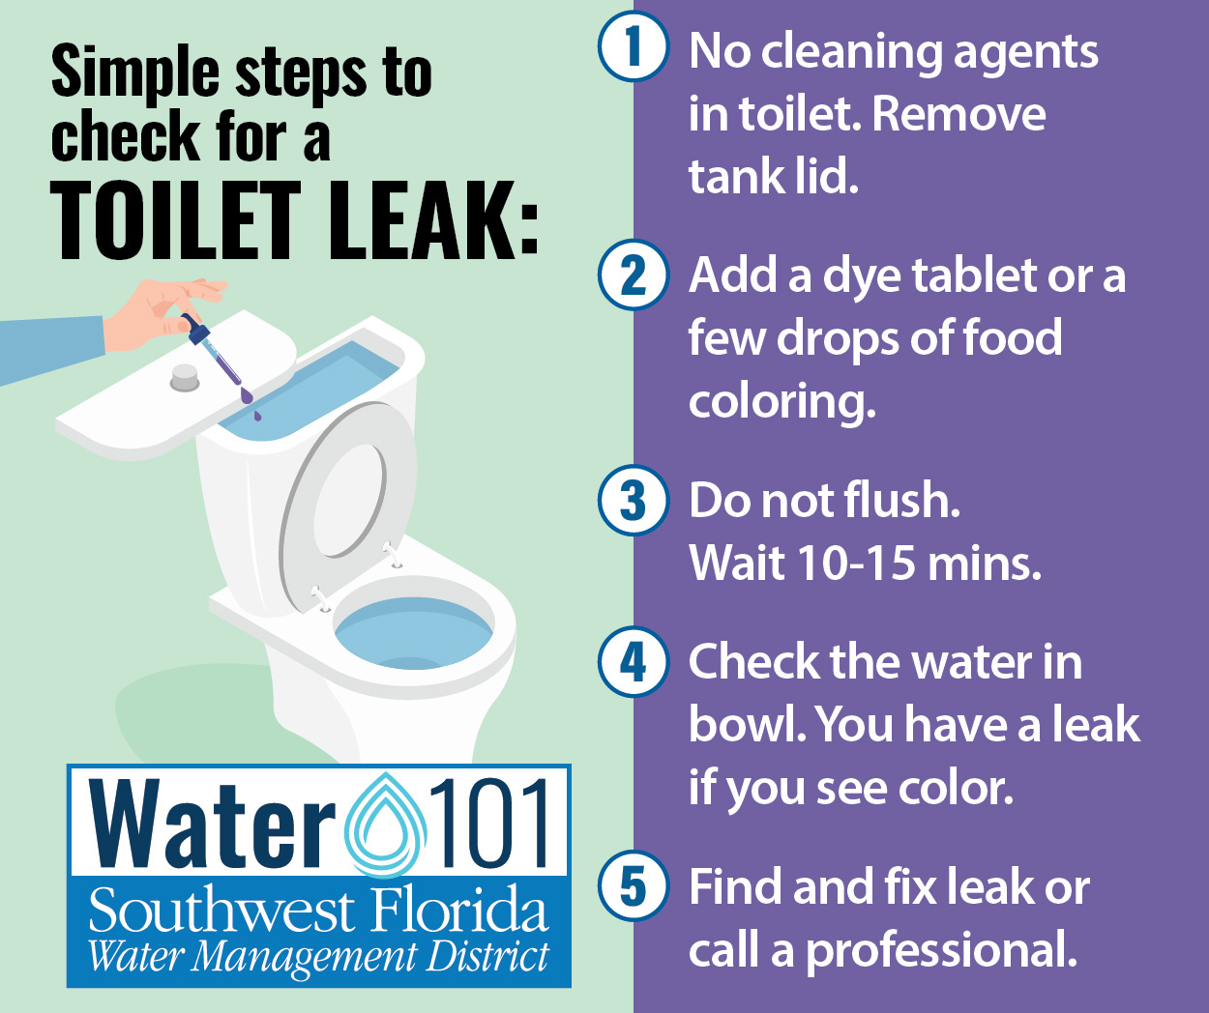
Save Water Indoors – Check for Leaks
Notes:
In specifically looking at toilets, a leaky toilet can waste up to 200 gallons of water a day! To check for a toilet leak, conduct a simple color test:
Start with a clean toilet and remove the toilet tank lid.
Add a dye tablet, leak detector fluid or a few drops of food coloring to the tank.
Wait 10-15 minutes and do not flush the toilet.
Look in the toilet bowl. If color has appeared in the bowl, you have a leak.

Slide 44
Save Water Indoors
Kitchen
Thaw foods in the refrigerator instead of running water over the food
Only run dishwasher when it’s full
Bathroom
Turn off the water while brushing your teeth or shaving
Take shorter showers
Notes:
Here are some other simple tips you can practice to reduce your water use inside.
In the kitchen, thaw foods in the refrigerator instead of running water of the food. Also be sure to only run full loads in the dishwasher. Same goes for running the clothes washer.
In the bathroom, turn off the water while brushing your teeth or shaving. Also try to take shorter showers.

Slide 45
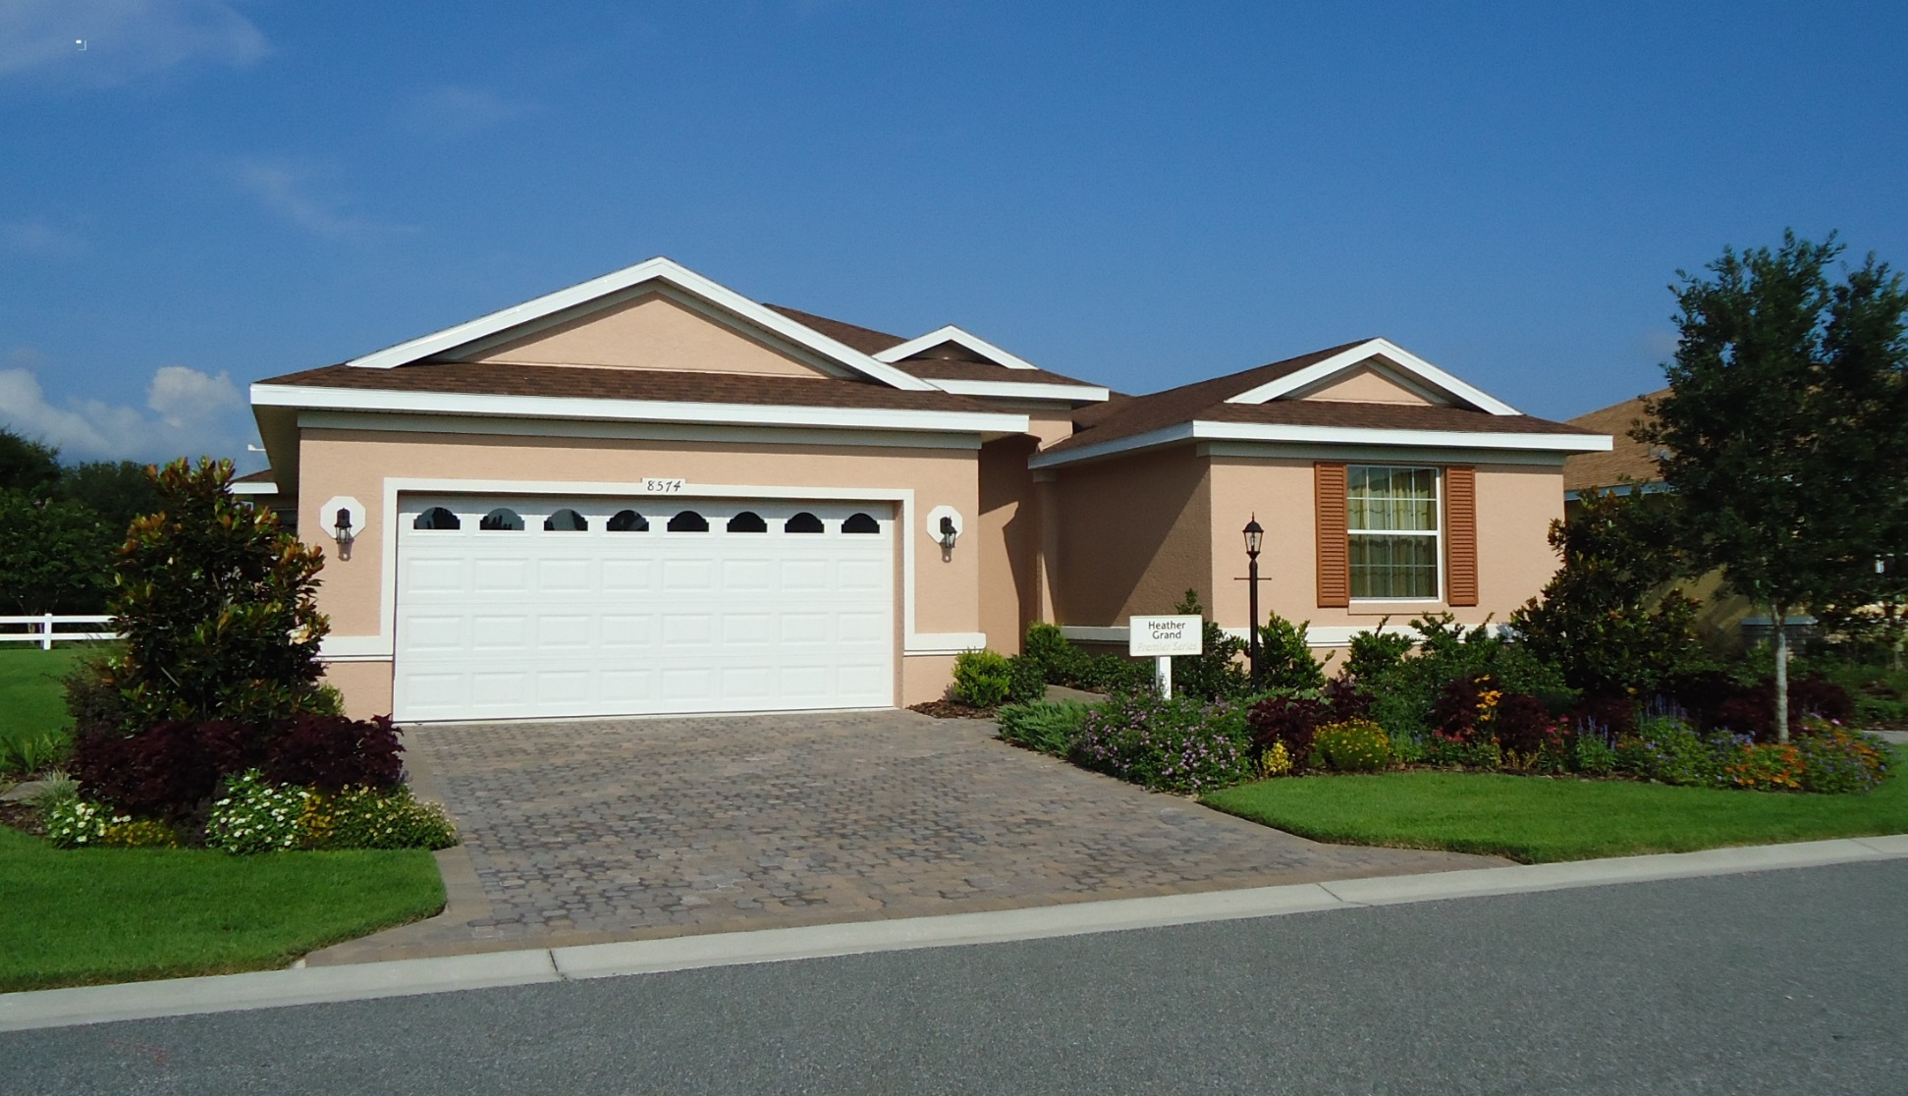
Save Water Outdoors
Reduce Irrigated Turf
Notes:
Switching from inside to outside now, did you know that in households with inground irrigation, roughly half of the water used by the household is used for irrigation?
One of the best ways to conserve water in your landscape is to reduce the amount of irrigation needed for your turf grass.
You can do this by selecting drought-tolerant turf grass that doesn’t require irrigation.
Another option to reduce water use is to enlarge your plant beds, which is aesthetically pleasing, less maintenance and uses less fertilizers and pesticides.

Slide 46
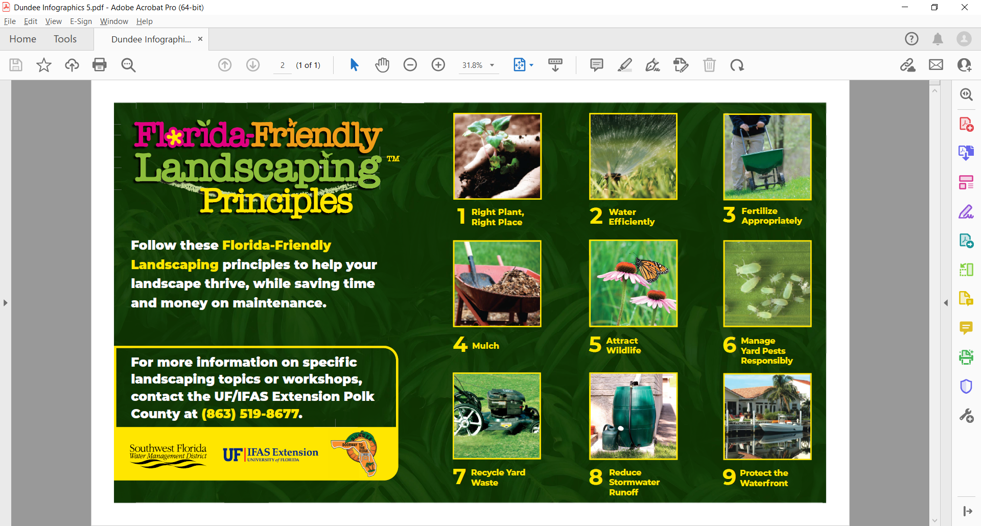
Florida-Friendly LandscapingTM
1. Right Plant, Right Place
2. Water Efficiently
3. Fertilize Appropriately
4. Mulch
5. Attract Wildlife
6. Manage Yard Pests Responsibly
7. Recycle Yard Waste
8. Reduce Stormwater Runoff
9. Protect the Waterfront
Notes:
Florida-Friendly Landscaping™ (FFL) is the state of Florida’s premier Extension program that promotes sustainable alternatives to “conventional” landscaping based on research and science.
You can see the nine principles here or check them out online later. I’ll provide a website for resources at the conclusion of the presentation.

Slide 47
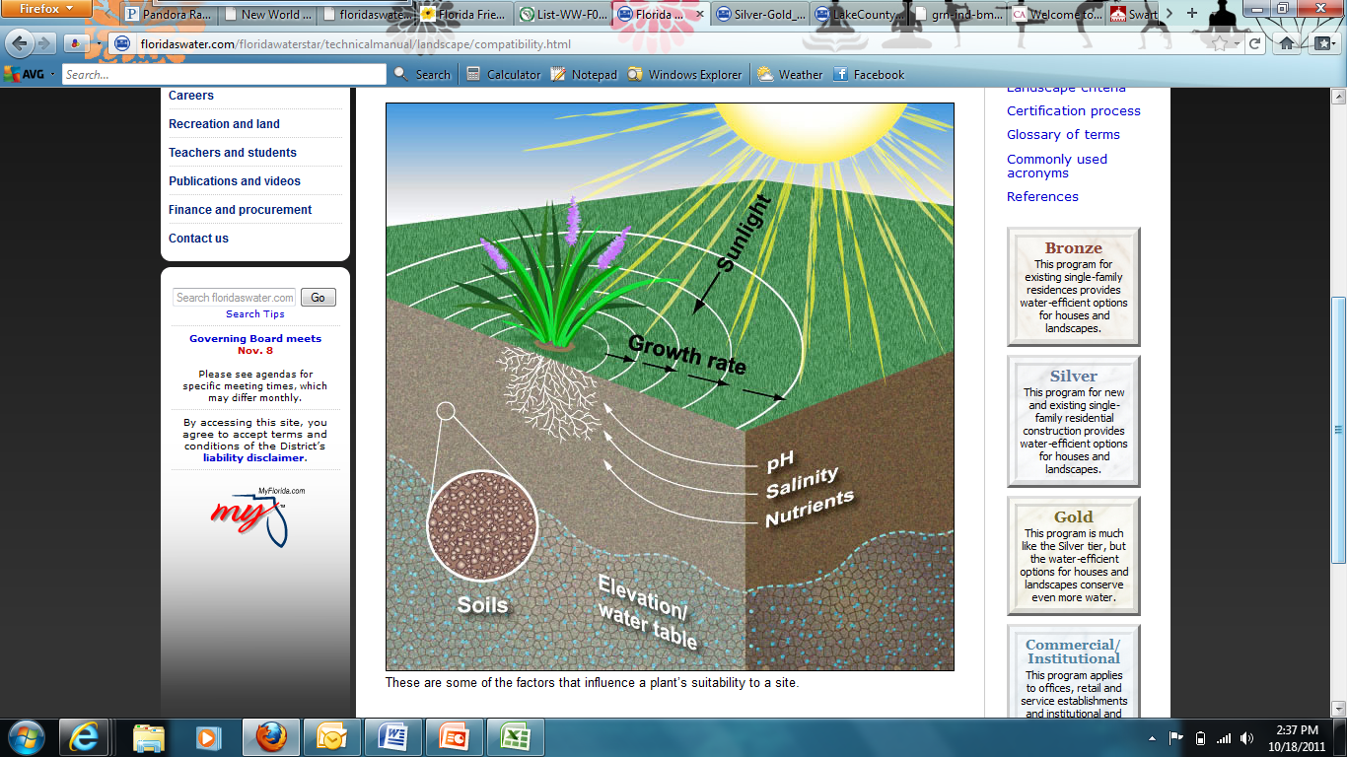
Right Plant, Right Place
Consider:
Sun/shade tolerance
Size at maturity
Acidic or alkaline soil
Wind/salt tolerance
Notes:
One of the Florida Friendly Landscaping principles, is right plant, right place.
It simply means when selecting landscape plants, consider the amount of sunlight or shade available to the plant, the height and width of your plant at maturity, whether you have clay or sandy soils and also wind and salt tolerance.
These factors are important to consider because an unhealthy, stressed plant is a needy plant, meaning it will then potentially need more water, fertilizer and maintenance to thrive.
You can reference the Florida Friendly plant database online for more information on what plants would be right for you.
Also, when installing plants, make sure they are not covered by eaves or overhangs as they will receive less water from rain and need to be watered more often.

Slide 48
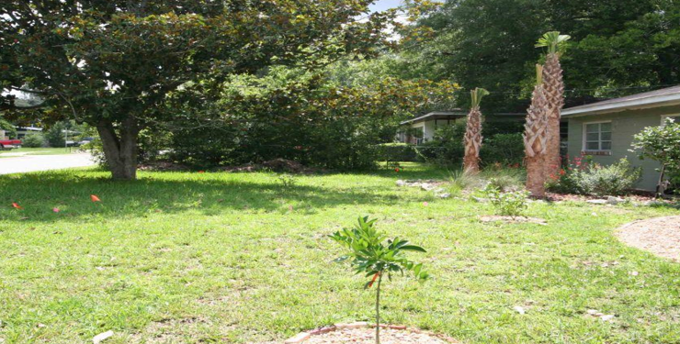
Plant More Trees
Lower Evapotranspiration
Higher Evapotranspiration
Notes:
Installing additional trees in your yard will reduce the amount of supplemental irrigation needed for your turf area due to less evapotranspiration.
An example of a large and hardy shade tree is a live oak, which is very common throughout Florida.

Slide 49
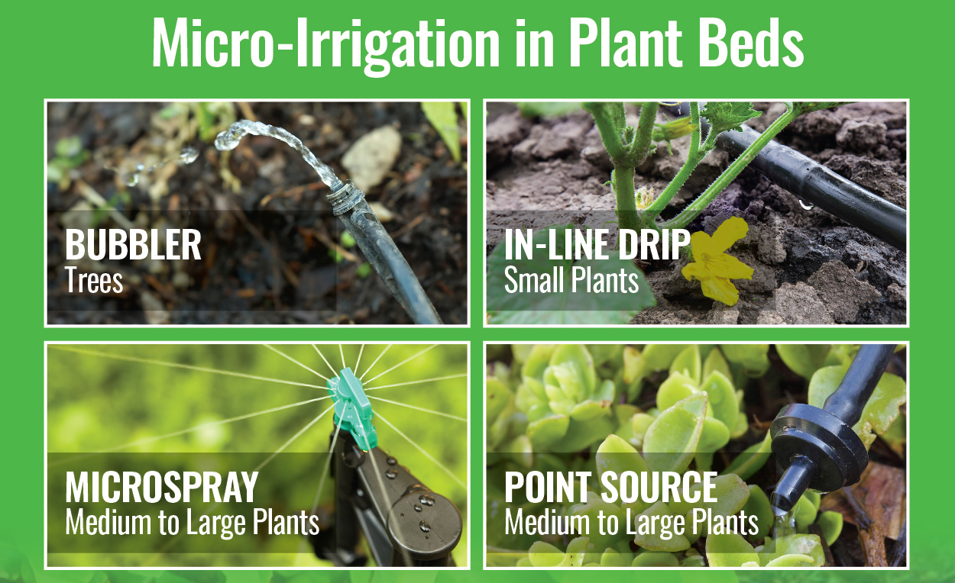
Micro-Irrigation
Notes:
TRIVIA – could ask before switching to this slide – What is micro irrigation and how does it save water?
Micro-irrigation is an excellent way to conserve water on your plants, trees and shrubs. This works by using less water per minute and allowing the water to go right to the root of the plant.
This minimizes weeds and disease, reduces erosion on slopes and saves you water and money!
There are four type of micro-irrigation available depending on the plant size.
Bubblers are best for trees
In-line drip tubing may be used for small plants
Micro-sprays or point source emitters may be used for medium to large plants
And, if you sign up for the District’s Water 101 newsletter on the sheet I brought today, you’ll be registered into a drawing for a chance to win a free micro-irrigation kit valued at $40.

Slide 50
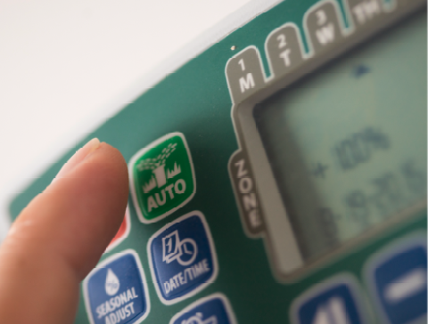
Irrigation Controller Basics
Check local watering restrictions for irrigation
start times and watering days.
Notes:
Another important part of saving water outdoors is making sure your irrigation controller is set to water wisely.
First and foremost, double check your local watering restrictions for irrigation start times and watering days.
If asked more about irrigation controllers:
Here are three main things to check on your irrigation controller:
Irrigation start time: This represents what time your irrigation system will begin watering. Only one start time is needed to initiate watering for all zones. It is recommended to set a start time before 10 a.m. or after 4 p.m.
Irrigation run time: This represents how long each zone in your irrigation system will run. Check with your local UF/IFAS Extension office for run time recommendations.
Irrigation schedule: This represents which days of the week your irrigation system will run. It is recommended to only run your system one to two days a week and only if needed.

Slide 51
Check Your Rain Sensor
Notes:
Florida homes with an in-ground irrigation system are required to have a rain shut-off device, most commonly a rain sensor.
Rain sensors prevent sprinklers from running after a moderate rainfall, saving you water and money. Rain sensors are typically located on rooflines and should be unobstructed by trees or overhangs.
Periodically, check your rain sensor to ensure it is working properly.

Slide 52

Seasonal Adjustments
Winter – “Skip a Week” of irrigation
Summer – “Watch the Weather, Wait to Water”
Only water as needed!
Notes:
Additional water saving tips include:
Make seasonal irrigation adjustments. For example, in the cooler winter months, plants need less water and you may be able to skip a week of irrigation, only watering every 10-14 days.
During the summer rainy season, watch the weather and wait to water your lawn only if supplemental irrigation is needed.

Slide 53
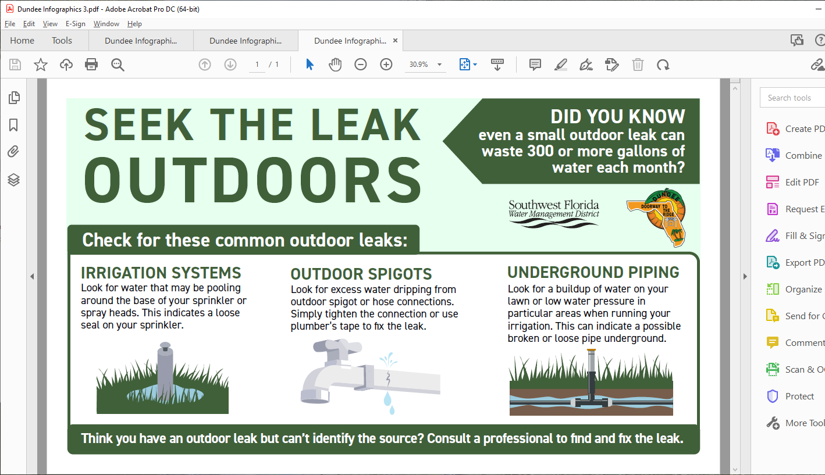
Save Water Outdoors – Check for Leaks
Irrigation System
Outdoor Spigots
Underground Piping
Notes:
Checking for leaks outdoors, is just as important as checking for them indoors. Even a small outdoor leak can waste 300 or more gallons of water each month.
Common places to look for an outdoor leak include:
Your irrigation system: Look for water that may be pooling around the base of your sprinkler or spray heads. This indicates a loose seal on your sprinkler. You’ll also want to check for broken or misdirected spray heads that are shooting water into the air, or along sidewalks or driveways.
Outdoor spigots: Look for excess water dripping from outdoor spigots or hose connections. Simply tighten the connection or use plumber’s tape to fix the leak.
Underground piping: Look for buildup of water on your lawn or low water pressure in particular areas when running your irrigation. This can indicate a possible broken or loose pipe underground.

Slide 54
Protecting Water Quality
Notes:
We’ve talked a lot about water conservation, but protecting water quality is important too.

Slide 55
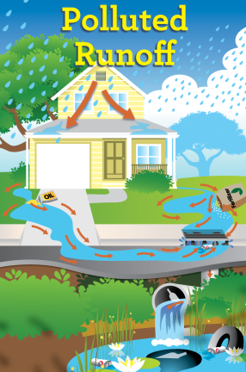
What we do on land impacts water resources.
Notes:
One of the biggest things to keep in mind when protecting our water resources at home, is that what we do on land impacts our waterways.

Slide 56
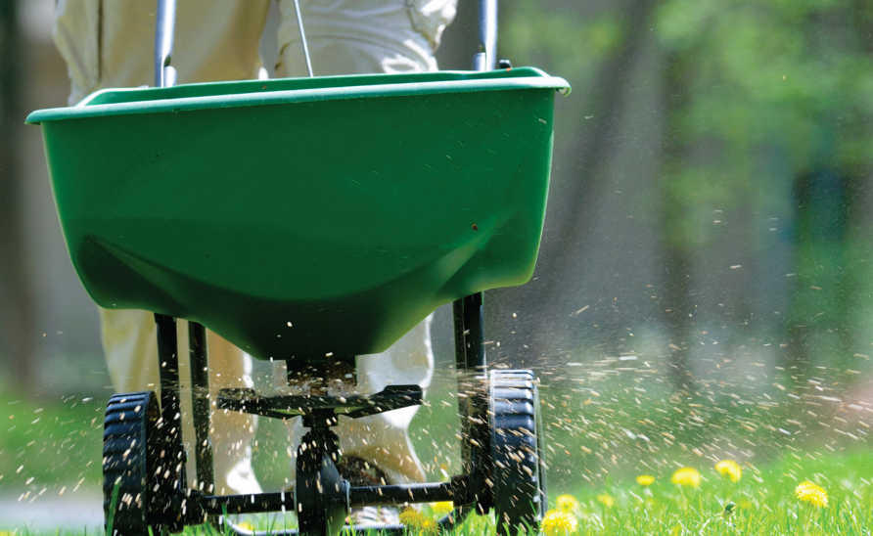
Florida-Friendly Fertilizing
Step 1: Check Local Fertilizer Regulations
Step 2: Conduct a Soil Test
Step 3: Choose the Right Fertilizer
Step 4: Apply Fertilizer at the Right Time
Step 5: Water Properly After Fertilizing
Notes:
Sometimes Florida yards need fertilizer to help keep them healthy, but applying too much fertilizer, too often or at the wrong time can cause water pollution.
Step 1: Check local fertilizer regulations. Many counties and cities in Florida have fertilizer ordinances to reduce nutrient runoff, including blackout dates on fertilizer use. You should always check local ordinances before fertilizing. In addition to local ordinances, when to fertilize also depends on your lawn’s growth cycle.
Step 2: Conduct a soil test. Before purchasing or applying fertilizer, start with a soil test to determine what your lawn truly needs. Soil testing is the most effective way to assess nutrient levels (such as nitrogen, phosphorus and potassium) and soil pH.
Step 3: Choose the right fertilizer. Use slow-release or controlled-release fertilizers to nourish your lawn longer and reduce nutrient runoff into water bodies.
Step 4: Apply fertilizer at the right time. For example, never fertilize before a heavy rain and fertilize only when your grass is actively growing.
Step 5: Water properly after fertilizing. You only need to apply ¼ inch of water after fertilizing to help nutrients absorb into the soil without washing away.
You can find more information on the District’s website.

Slide 57
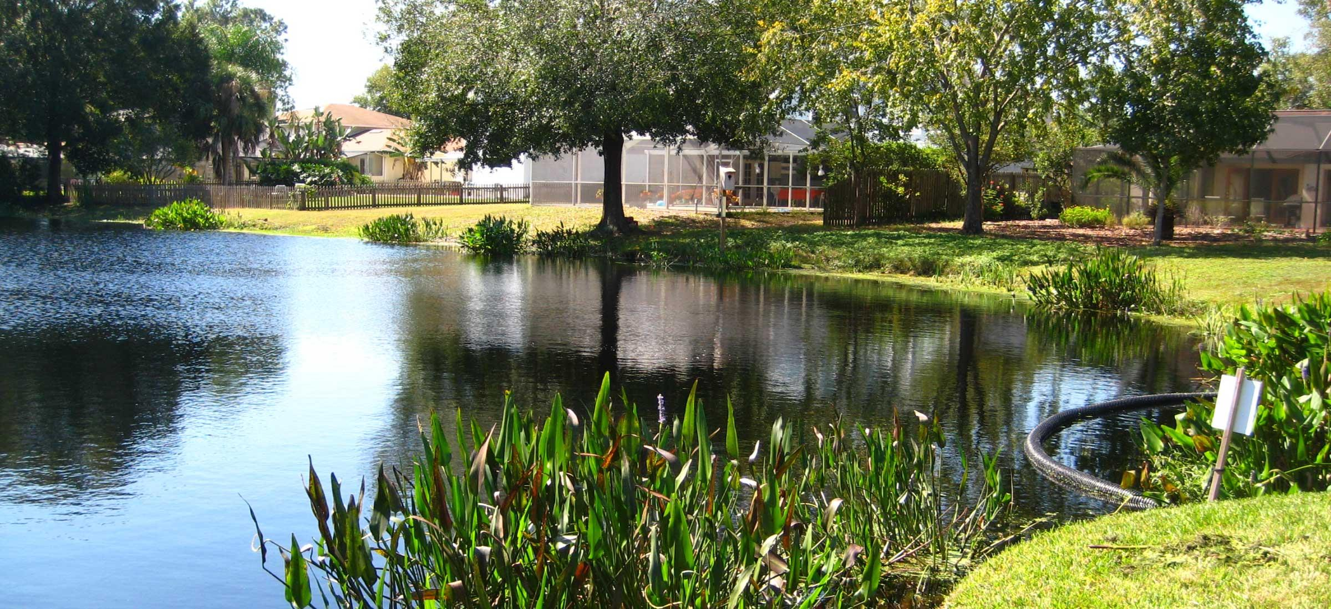
Stormwater Systems in your Neighborhood
Notes:
A stormwater system is designed to collect and manage runoff from rainwater. They are specifically designed to help prevent flooding and remove pollutants from the water.
When rainwater lands on rooftops, parking lots, streets, driveways and other hard surfaces, the rainfall that doesn’t soak into the ground is called stormwater runoff.
Stormwater runoff carries pollutants such as litter, motor oil, gasoline, fertilizers, pesticides, pet wastes, sediments and more.
Protecting natural waterbodies from these pollutants is important. There are many tips homeowners can follow to help, and communities can help too through proper maintenance of their stormwater systems.
In addition to following proper fertilizer techniques, other ways to protect water quality include:
Clean up pet wastes to avoid nutrients and bacteria from entering the stormwater drains and contaminating water.
Avoid cutting your lawn too short, which reduces its effectiveness in capturing runoff.
Never deposit lawn clippings in water bodies and storm drains as this can increase oxygen demand in the water, which can significantly harm fish populations.

Slide 58
Protecting Water Quality
Additional at-home tips:
Maintain septic systems
Never dump anything down a storm drain
Plant a shoreline buffer zone
Dispose of household chemicals, yard waste, motor oil and more appropriately
Notes:
Have septic tanks inspected every two to three years. Septic tanks that are not properly maintained can pollute the groundwater that ultimately emerges from springs.
Never dump anything down a storm drain, as this makes its way into local waterbodies.
Pending on your homes location, plant a shoreline buffer zone to help capture stormwater runoff before it reaches the waterway.
Always dispose of household chemicals, yard waste, motor oil and more appropriately.

Slide 59

Notes:
Don’t forget, if you sign up for the District’s Water 101 newsletter today, you’ll be registered into a drawing for a chance to win a free micro-irrigation kit valued at $40.
If asked about permitting:
We are a regulatory agency and anyone wanting to pump large quantities of water, must receive a permit from the water management district. When issuing permits, the District follows rules and a three-pronged approach to evaluate a permit. A) there is a need for the water and it will not be wasted B) withdrawals will not harm the water resources, the related environment, nor interfere with other existing users and C) the use is consistent with the public interest.

Slide 60
For More Information
Katherine Squitieri: Katherine.Squitieri@WaterMatters.org
District Website: WaterMatters.org
Water 101 Webpage: WaterMatters.org/Water101
Florida-Friendly LandscapingTM: FFL.ifas.ufl.edu
Notes:
Here are some helpful webpages for you. The District’s website is WaterMatters.org.
All of the information covered today and more can be found at our Water101 webpage at WaterMatters.org/Water101.
I’ve also included the Florida Friendly Landscaping web address.
I’ll leave this slide up if you want to take a photo or write down these websites.
Does anyone have any questions about the District?

Slide 61
Irrigation Zones
Sprinklers watering turf are on separate zones (valves) than landscape beds
Rotating sprinklers are on separate zones (valves) than spray sprinklers
Match hydrozones
Hydrozones
1 | Turfgrass
2 | Landscape Bed
3 | Landscape Bed
4 | Turfgrass
5 | Unirrigated Buffer Zone
Water (Pond)
5
3
4
3
2
House
1
2
2
Drive-way
1

Slide 62
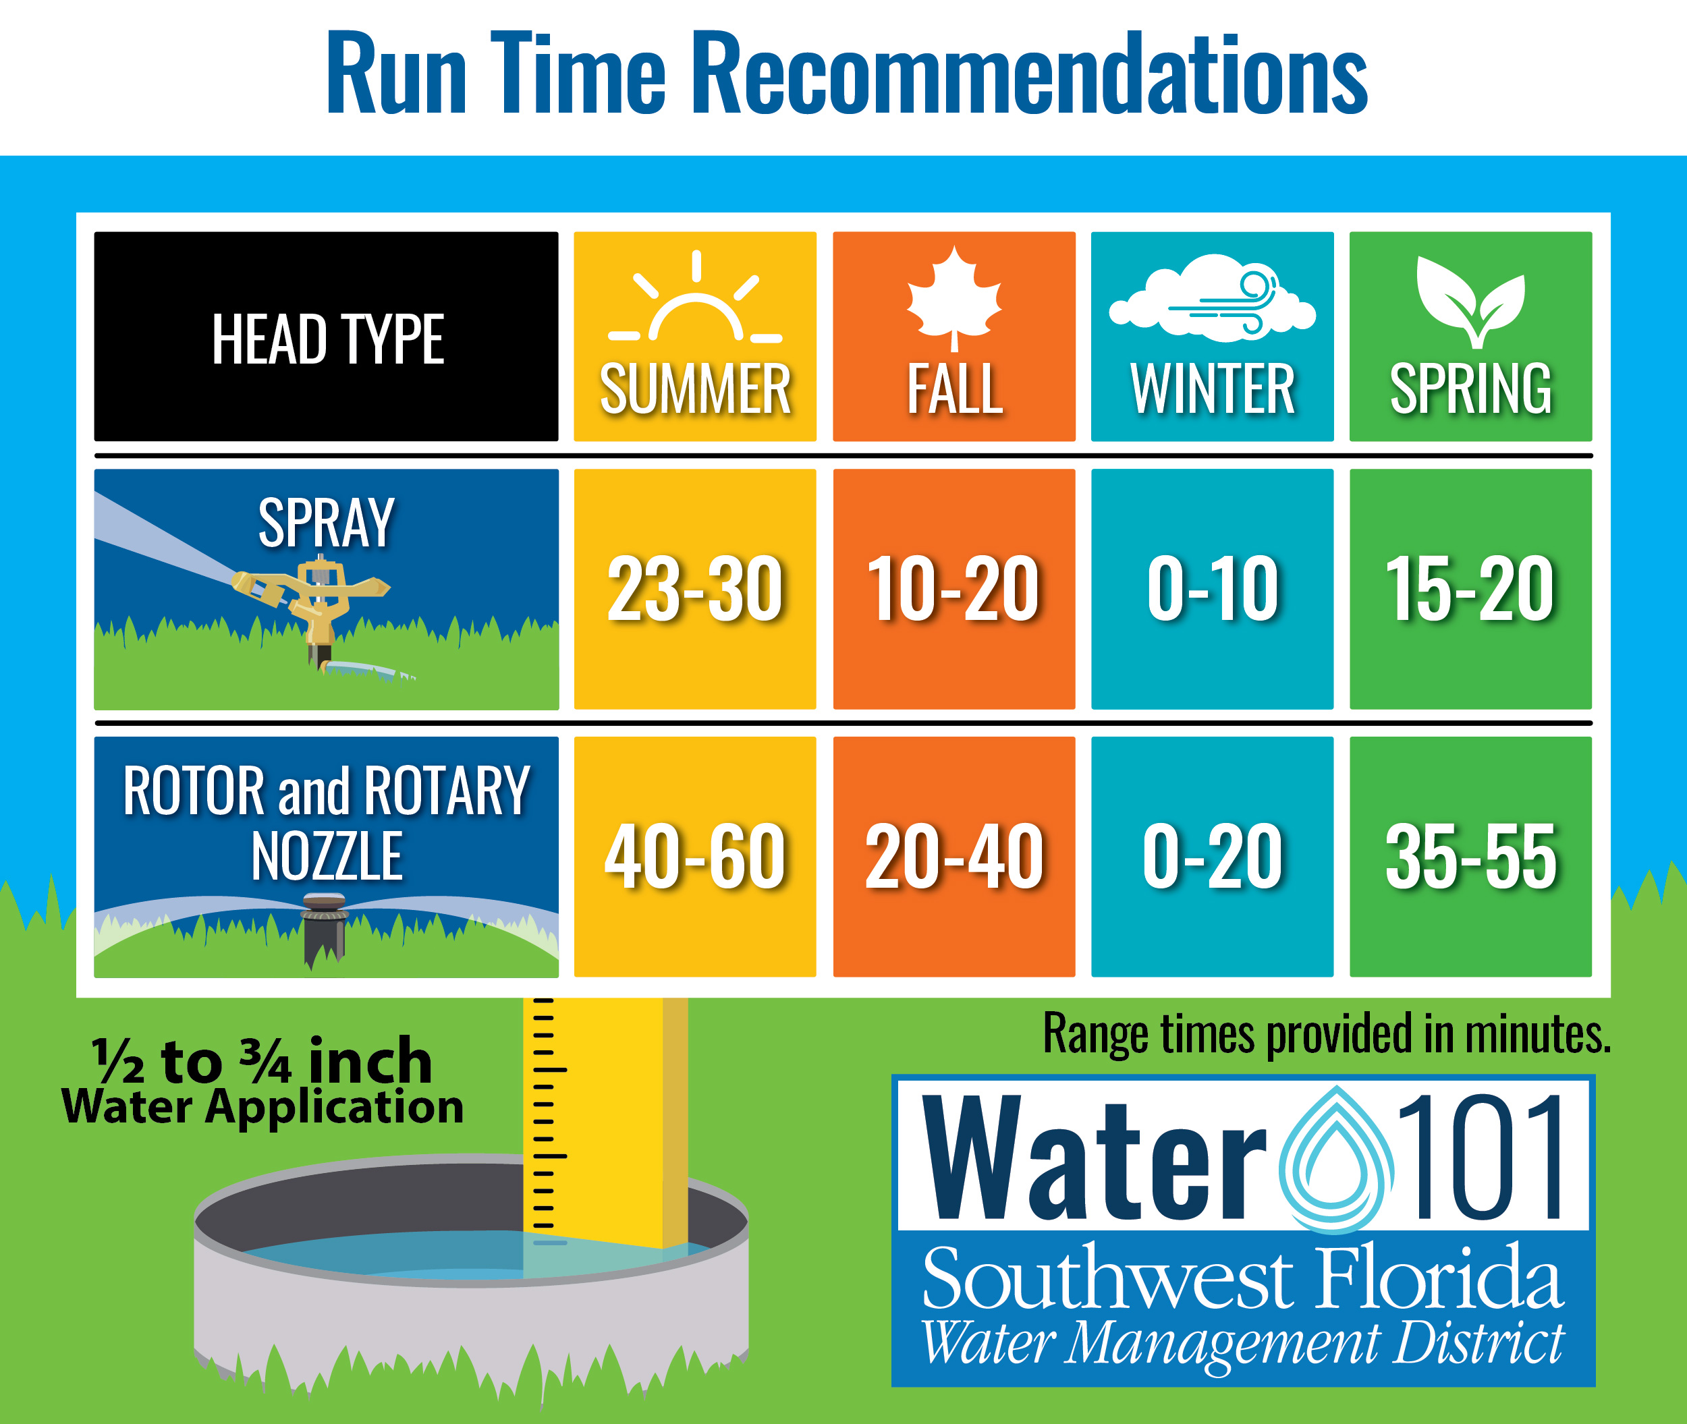

Slide 63
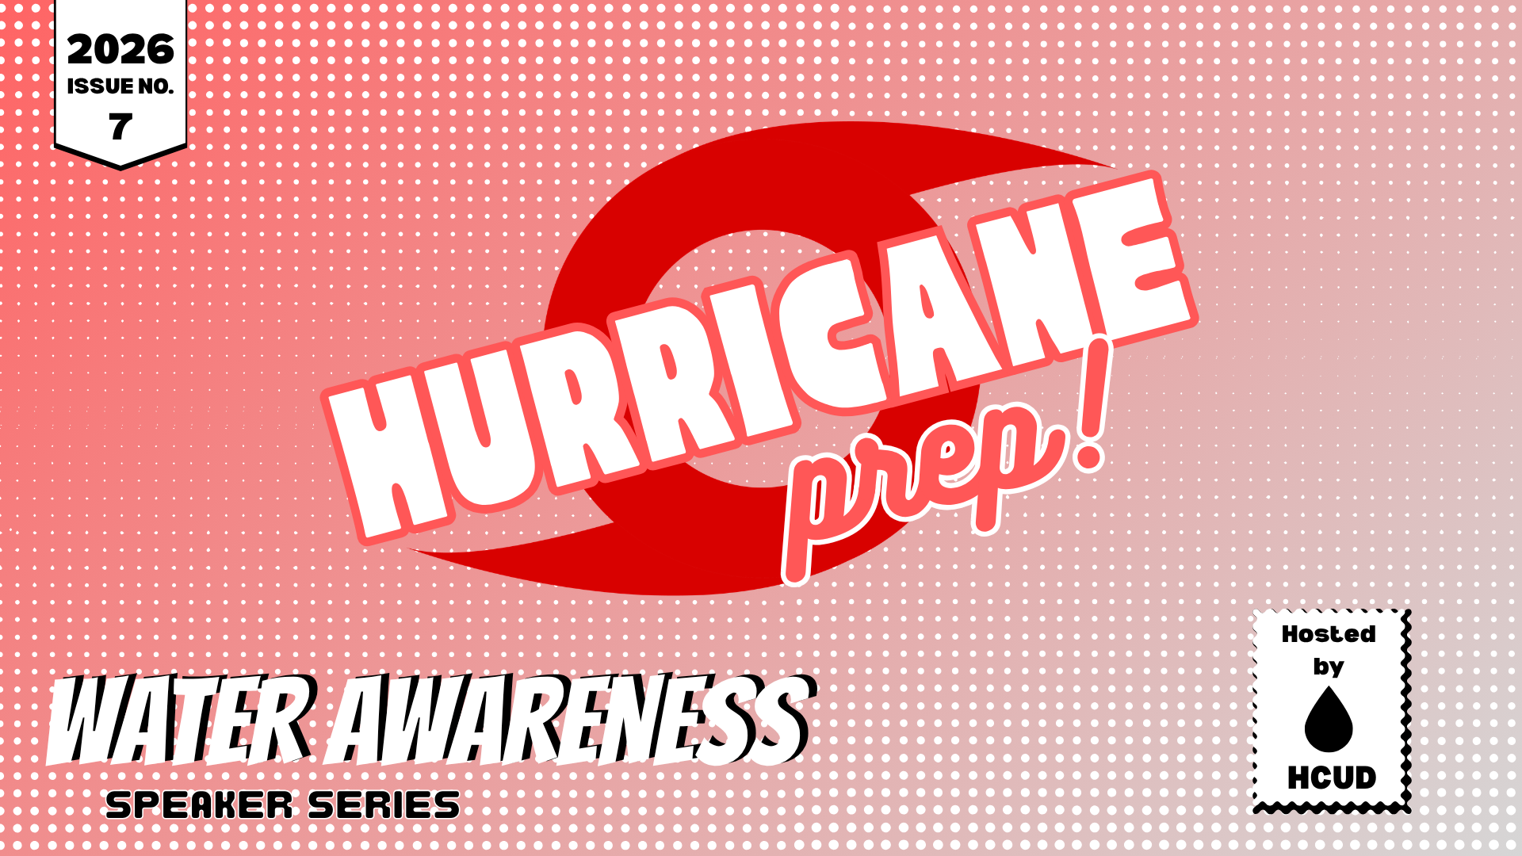

Slide 64


