Slide 1
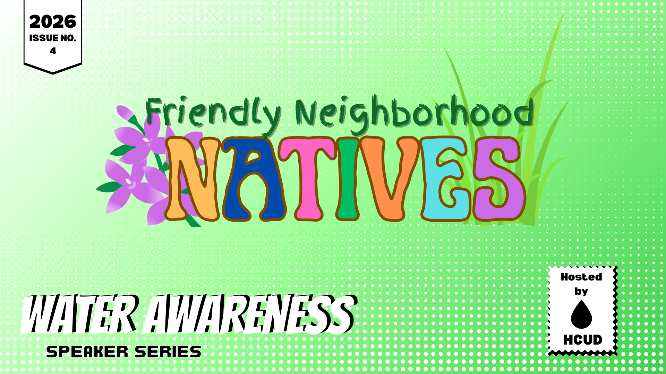

Slide 2
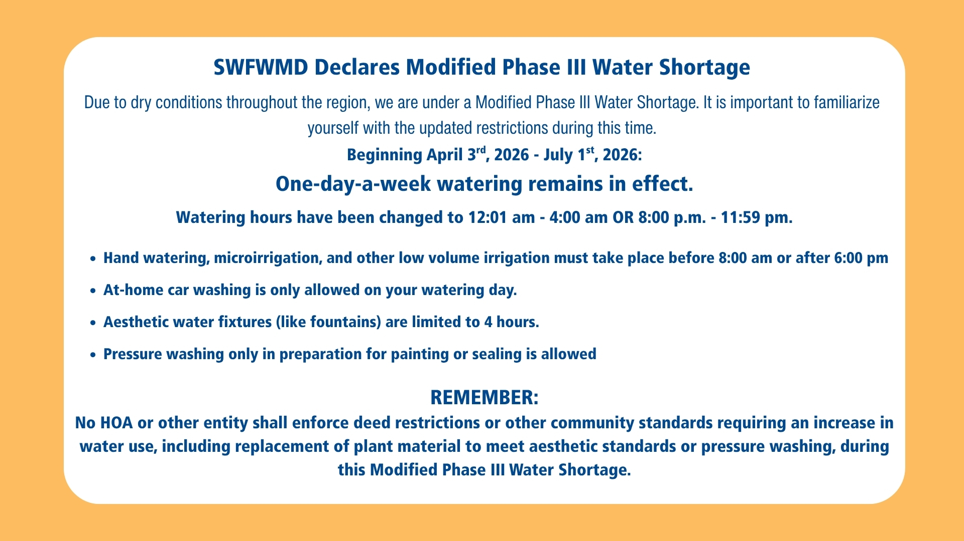

Slide 3
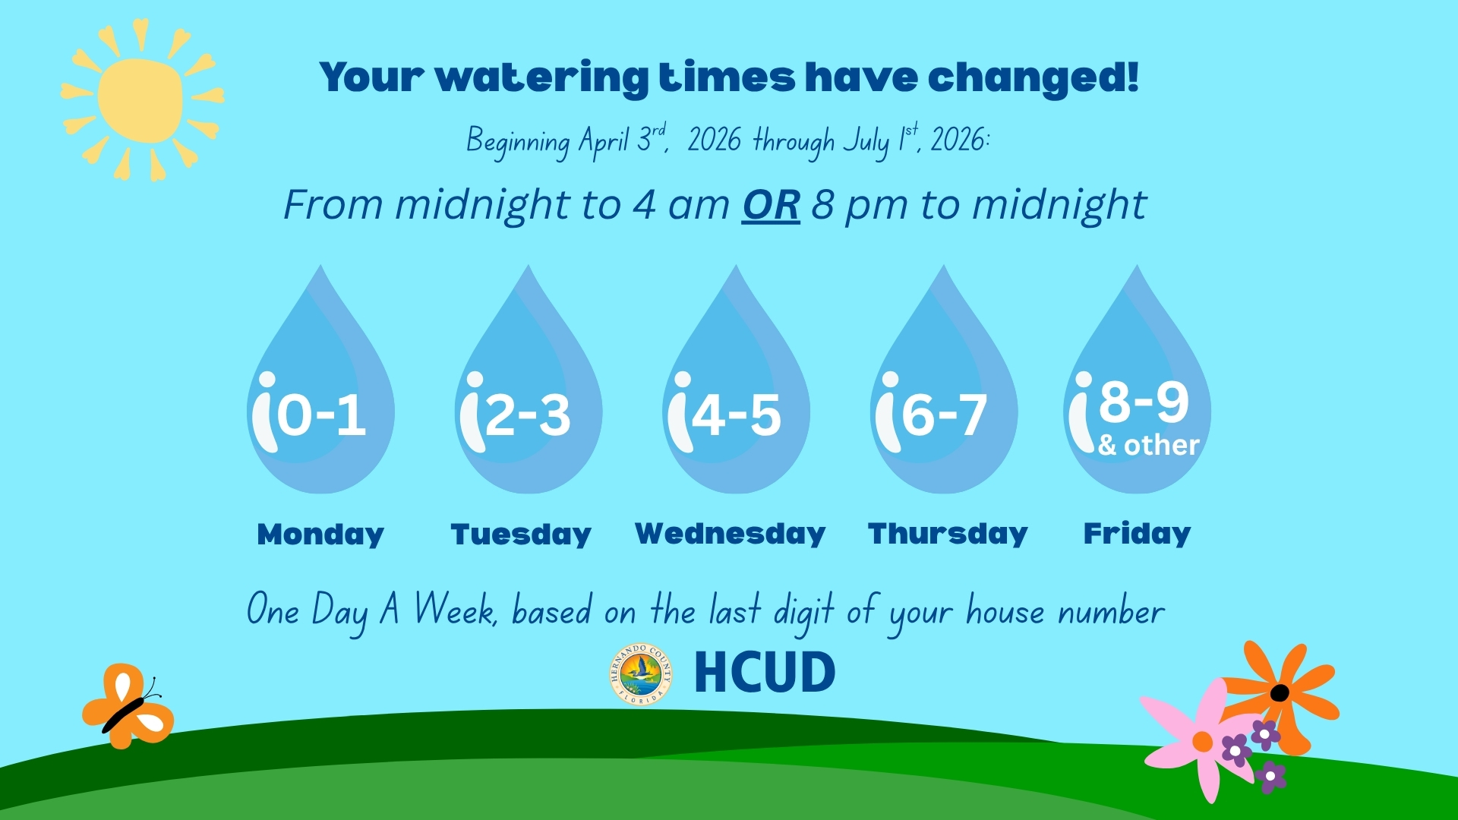

Slide 4
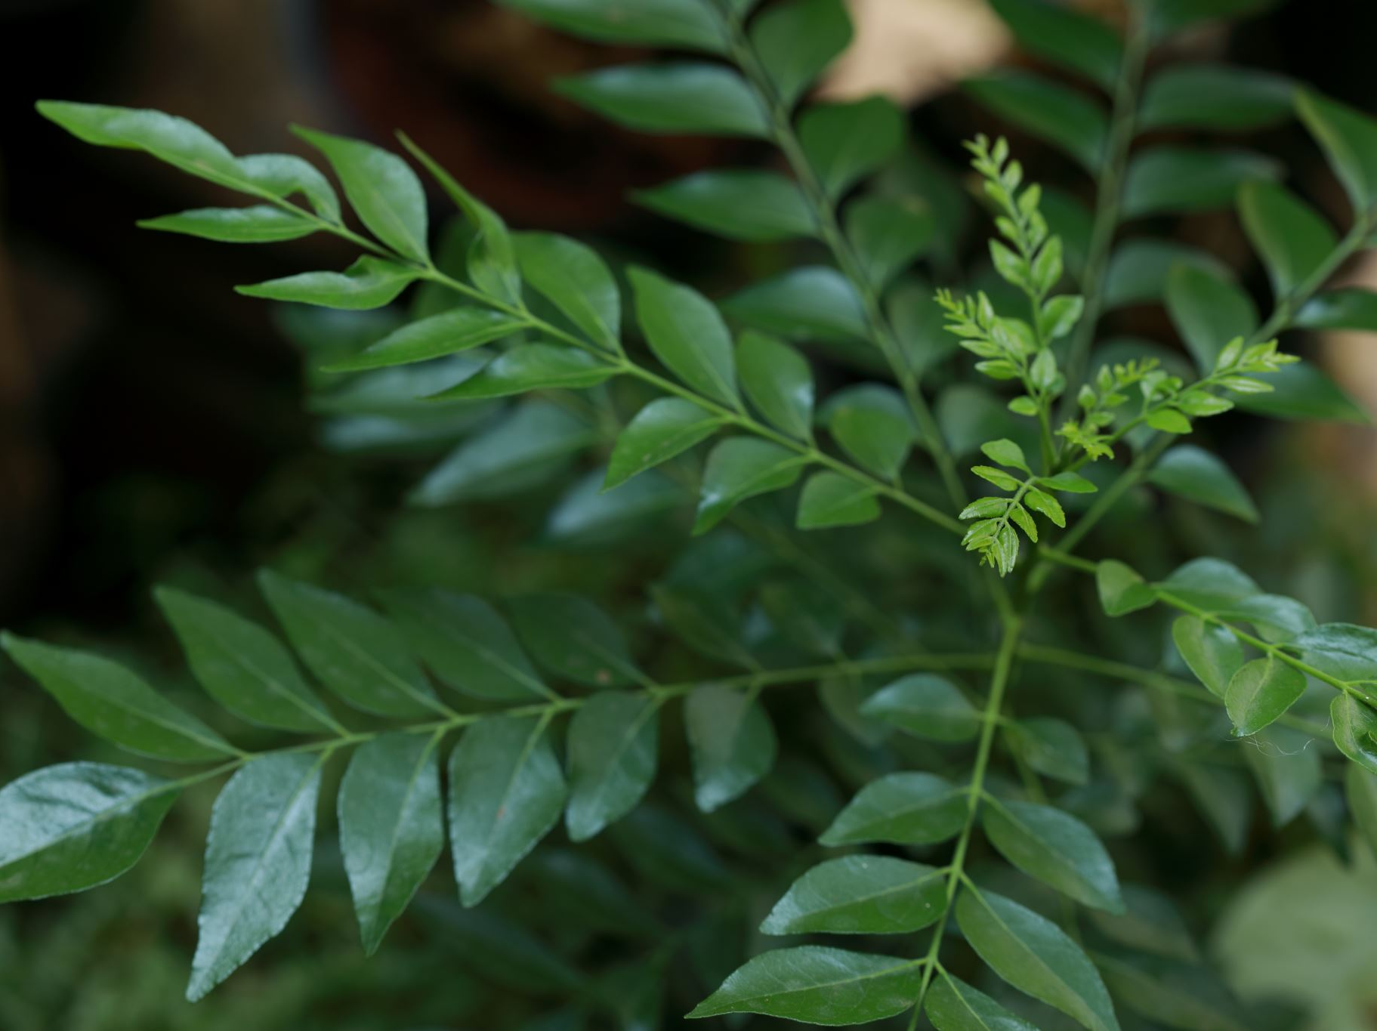
Native Plants in Hernando County
An overview of native flora and pollinators

Slide 5
Why Native Plants Matter
Adapted to local climate
Require less water and fertilizer
Support wildlife and pollinators

Slide 6
Hernando County Ecosystems
Sandhill
Flatwoods
Coastal marsh
Hardwood hammocks

Slide 7
Benefits to Pollinators
Provide nectar and pollen
Support native bees, butterflies, and moths
Enhance biodiversity

Slide 8
Soil and Climate Adaptation
Sandy soils common
Seasonal drought and heavy rains
Native plants thrive without amendments

Slide 9

Key Native Trees
Live Oak (Quercus virginiana)
Longleaf Pine (Pinus palustris)
Red Maple (Acer rubrum)

Slide 10
Key Native Shrubs
Beautyberry (Callicarpa americana)
Saw Palmetto (Serenoa repens)
Firebush (Hamelia patens)

Slide 11
Native Grasses
Muhly Grass (Muhlenbergia capillaris)
Wiregrass (Aristida stricta)
Fakahatchee Grass

Slide 12
Native Wildflowers
Coreopsis (State wildflower)
Blanketflower
Tickseed
Black-eyed Susan

Slide 13
Seasonal Blooming
Spring
Coreopsis, Lupine
Summer
Milkweed
Fall
Goldenrod

Slide 14
Milkweed and Monarchs
Critical host plant
Supports monarch butterfly lifecycle
Species: Swamp milkweed, Butterfly weed

Slide 15
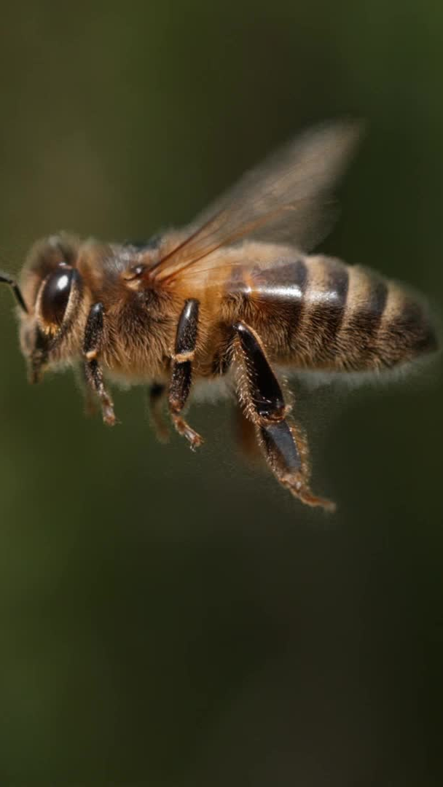
Native Bees
Over 300 species in Florida
Examples: Mason bees, Sweat bees
Prefer native plants

Slide 16
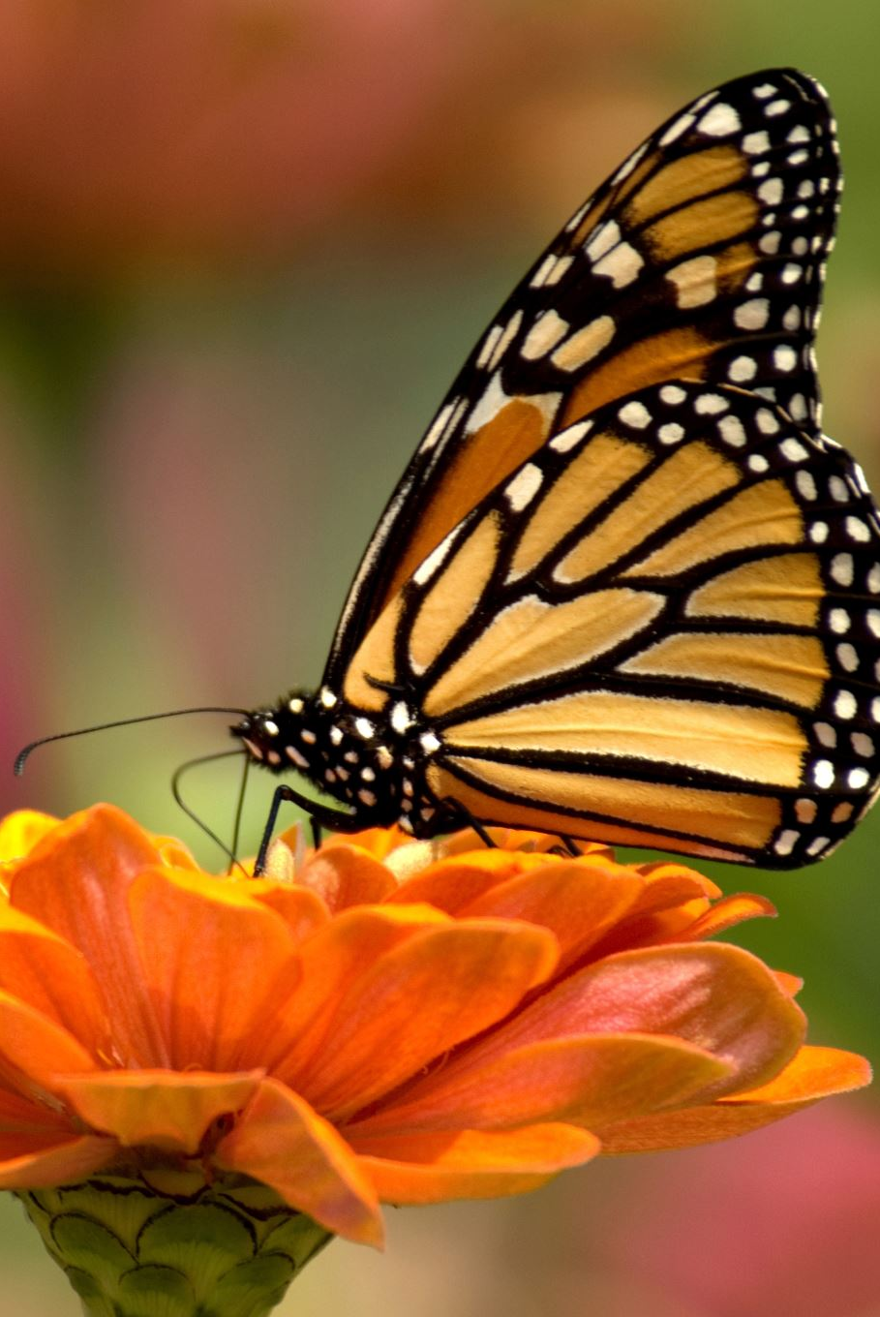
Butterflies of Hernando County
Zebra longwing
Gulf fritillary
Monarch
Require host plants

Slide 17
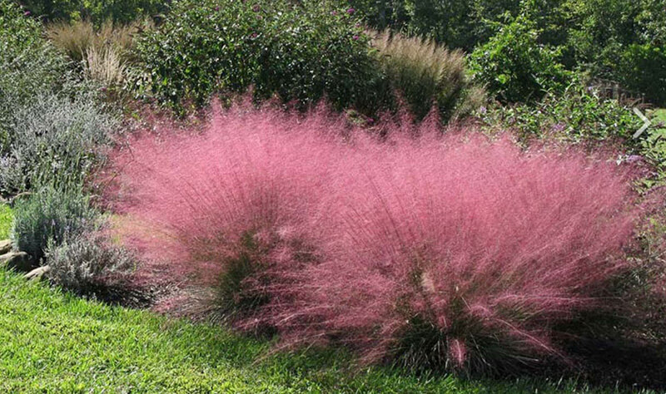
Muhly Grass
Native grass with pink blooms
Notes:
Discuss Muhly Grass and its role in Hernando County ecosystems.

Slide 18
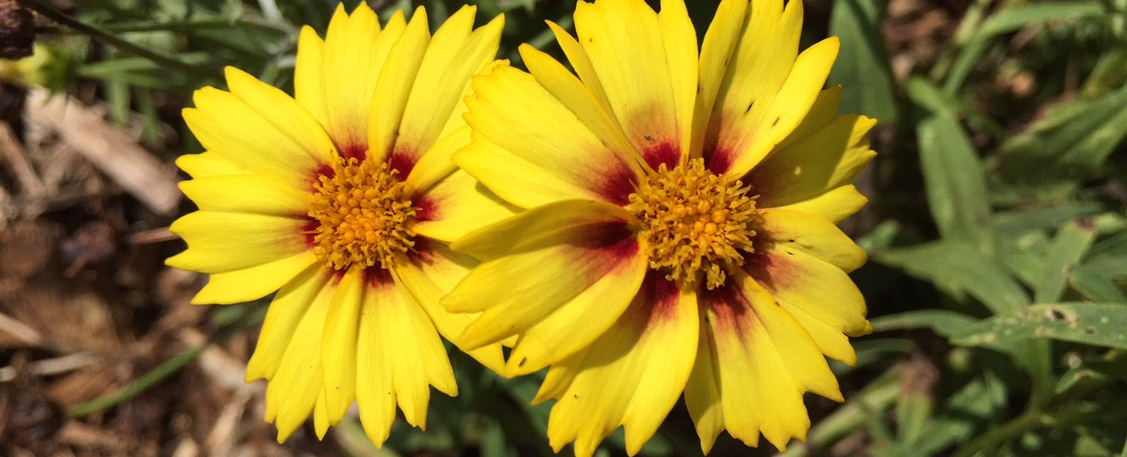
Coreopsis
Florida state wildflower
Notes:
Discuss Coreopsis and its role in Hernando County ecosystems.

Slide 19
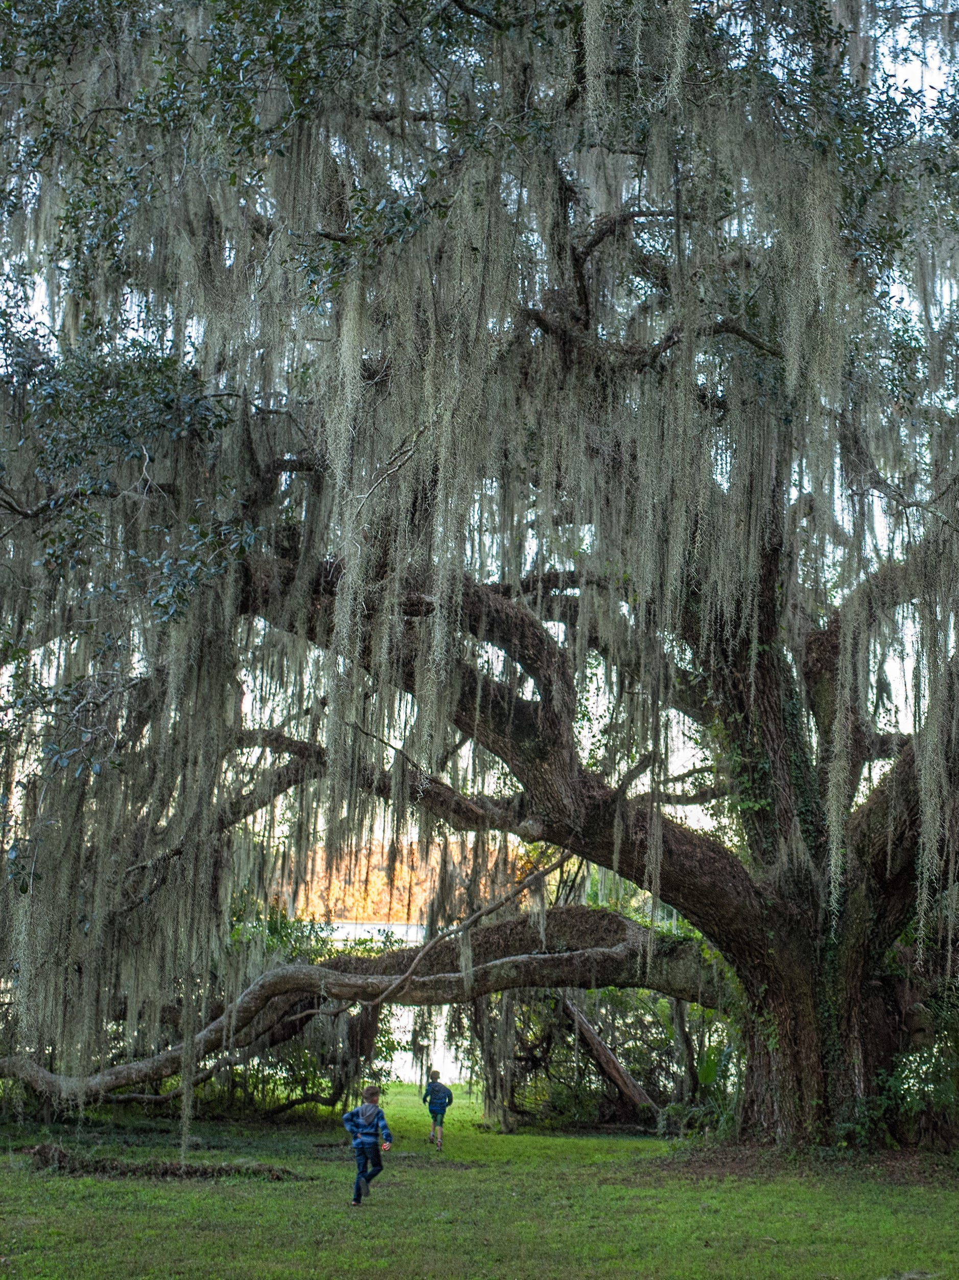
Live Oak
Iconic native tree
Notes:
Discuss Live Oak and its role in Hernando County ecosystems.

Slide 20
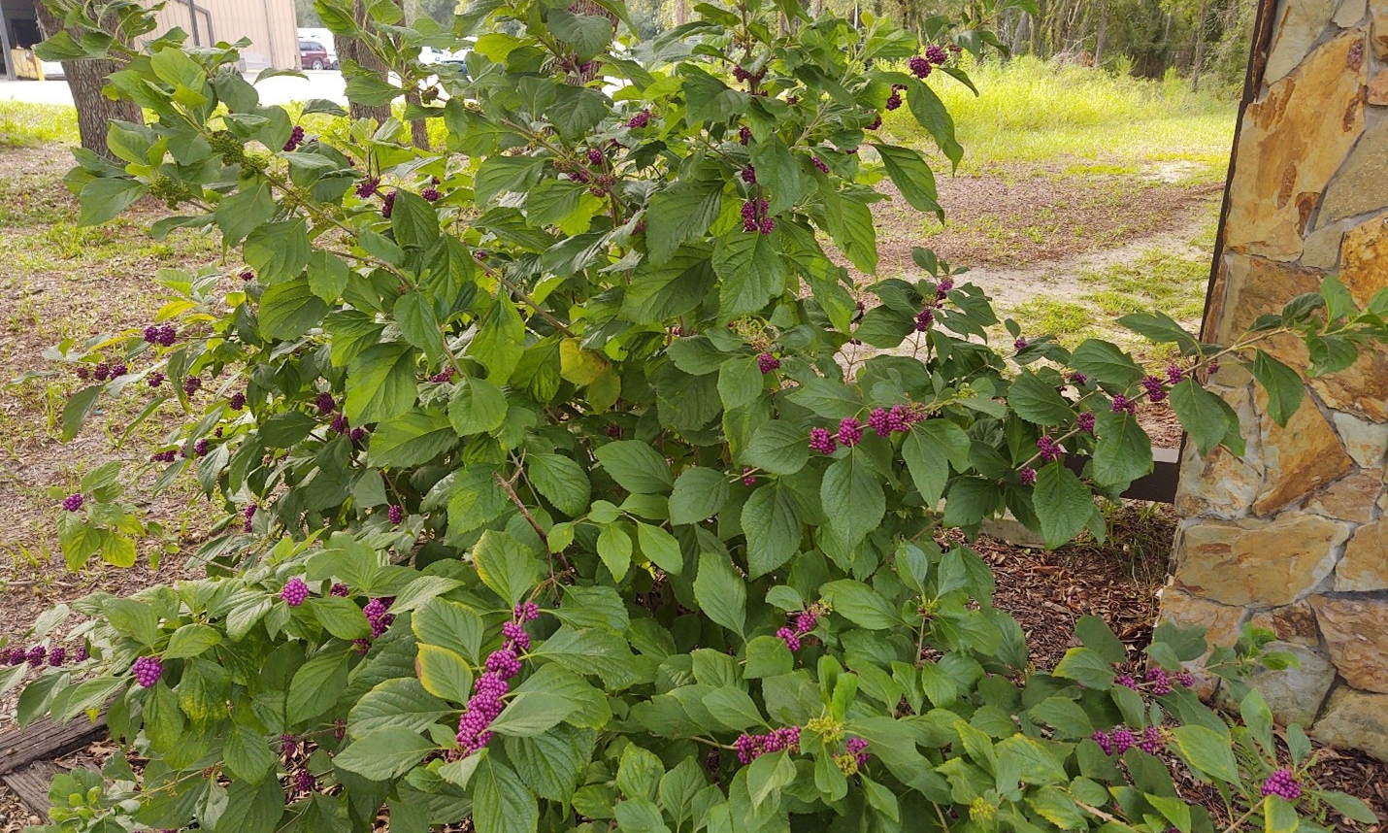
Beautyberry
Purple berries shrub
Notes:
Discuss Beautyberry and its role in Hernando County ecosystems.

Slide 21
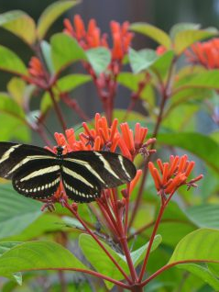
Firebush
Pollinator favorite
Notes:
Discuss Firebush and its role in Hernando County ecosystems.

Slide 22
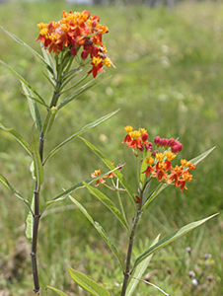
Milkweed
Monarch host plant
Notes:
Discuss Milkweed and its role in Hernando County ecosystems.

Slide 23
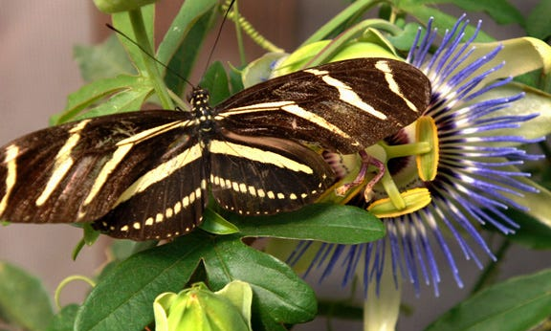
Zebra Longwing
State butterfly
Notes:
Discuss Zebra Longwing and its role in Hernando County ecosystems.

Slide 24
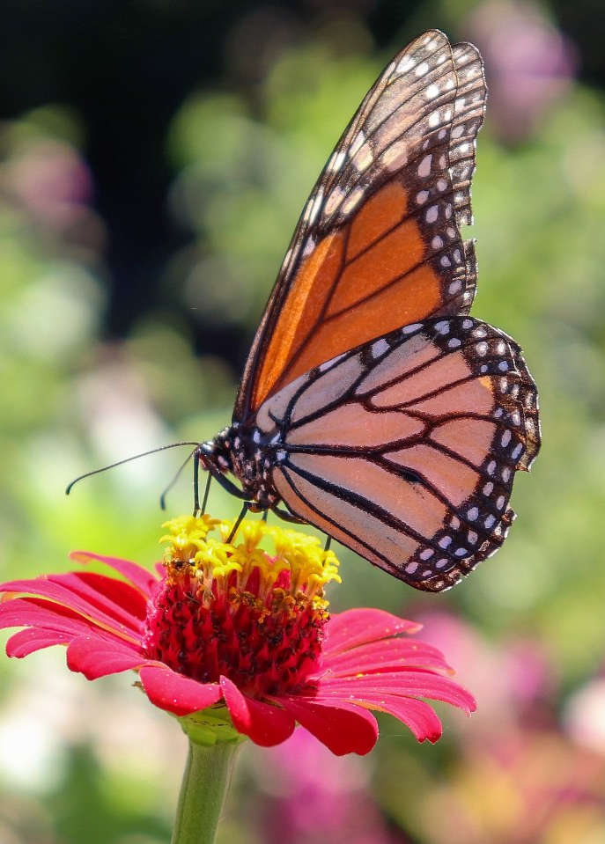
Monarch Butterfly
Migratory pollinator
Notes:
Discuss Monarch Butterfly and its role in Hernando County ecosystems.

Slide 25
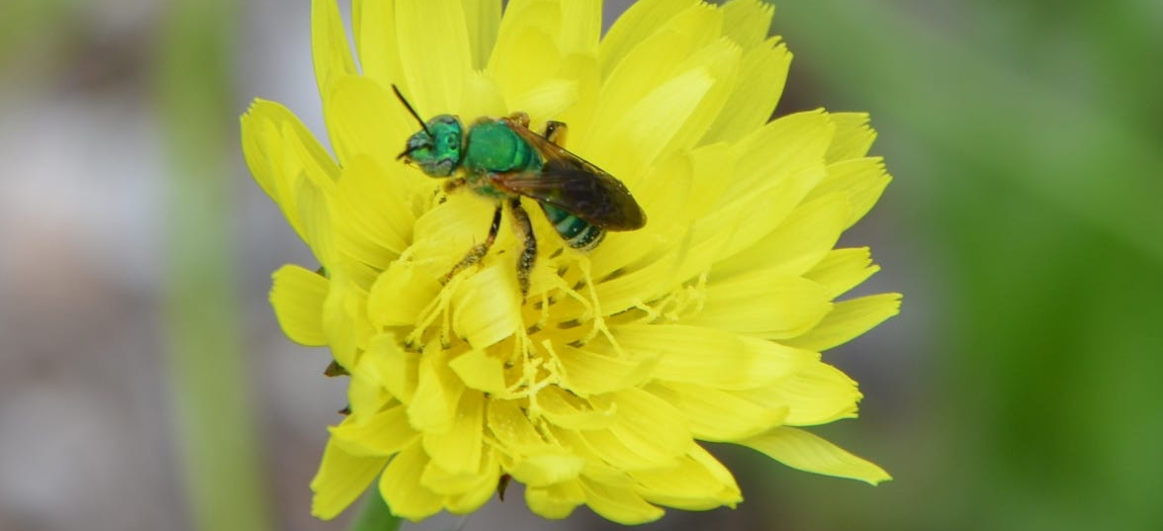
Native Bees
Important pollinators
Notes:
Discuss Native Bees and its role in Hernando County ecosystems.

Slide 26
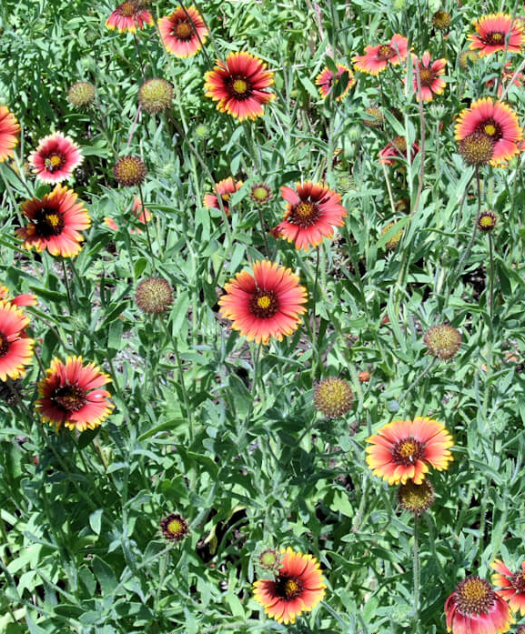
Blanketflower
Bright wildflower
Notes:
Discuss Blanketflower and its role in Hernando County ecosystems.

Slide 27
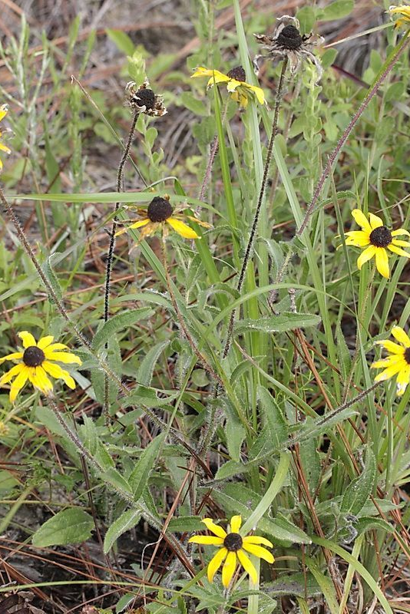
Black-eyed Susan
Summer bloomer
Notes:
Discuss Black-eyed Susan and its role in Hernando County ecosystems.

Slide 28
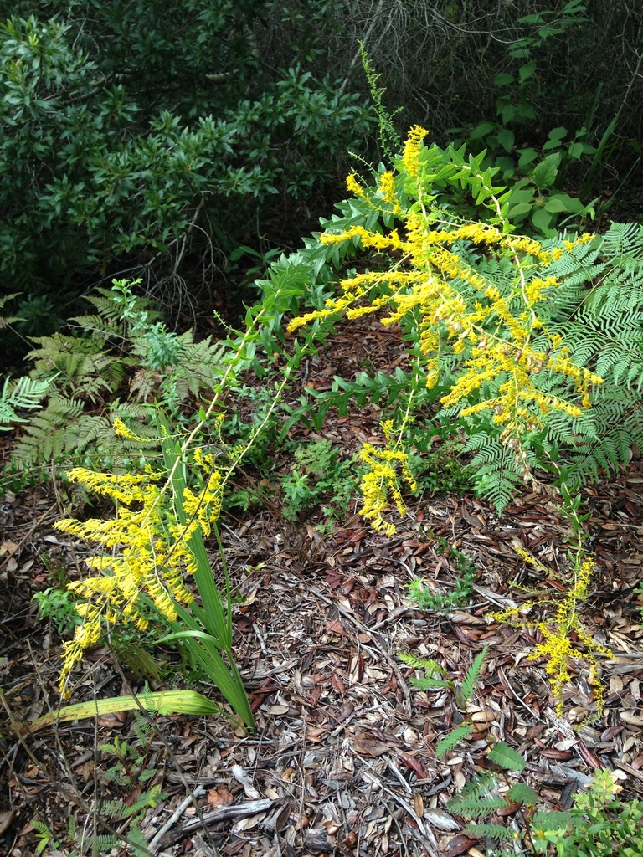
Goldenrod
Fall nectar source
Notes:
Discuss Goldenrod and its role in Hernando County ecosystems.

Slide 29
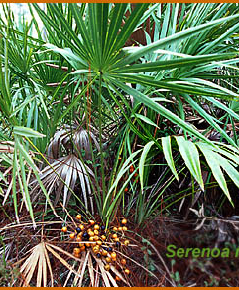
Saw Palmetto
Native shrub
Notes:
Discuss Saw Palmetto and its role in Hernando County ecosystems.

Slide 30
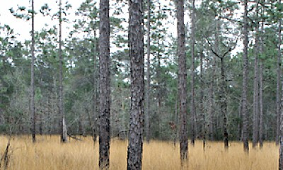
Wiregrass
Fire adapted grass
Notes:
Discuss Wiregrass and its role in Hernando County ecosystems.

Slide 31
Pollinator-Friendly Landscaping
Plant diversity
Continuous blooms
Avoid pesticides

Slide 32
Water Conservation
Native plants reduce irrigation
Deep root systems improve soil health

Slide 33
Wildlife Habitat
Supports birds, insects, and mammals
Provides food and shelter

Slide 34
Invasive vs Native
Invasives outcompete natives
Examples: Brazilian pepper
Promote native alternatives

Slide 35
Planting Tips
Right plant, right place
Plant in fall or early spring
Minimal fertilization needed

Slide 36
Resources
UF/IFAS Extension Hernando County
Florida Native Plant Society
FFL Program

Slide 37
Conclusion
Native plants support ecosystems
Enhance landscapes sustainably
Encourage pollinators

Slide 38
