Slide 1
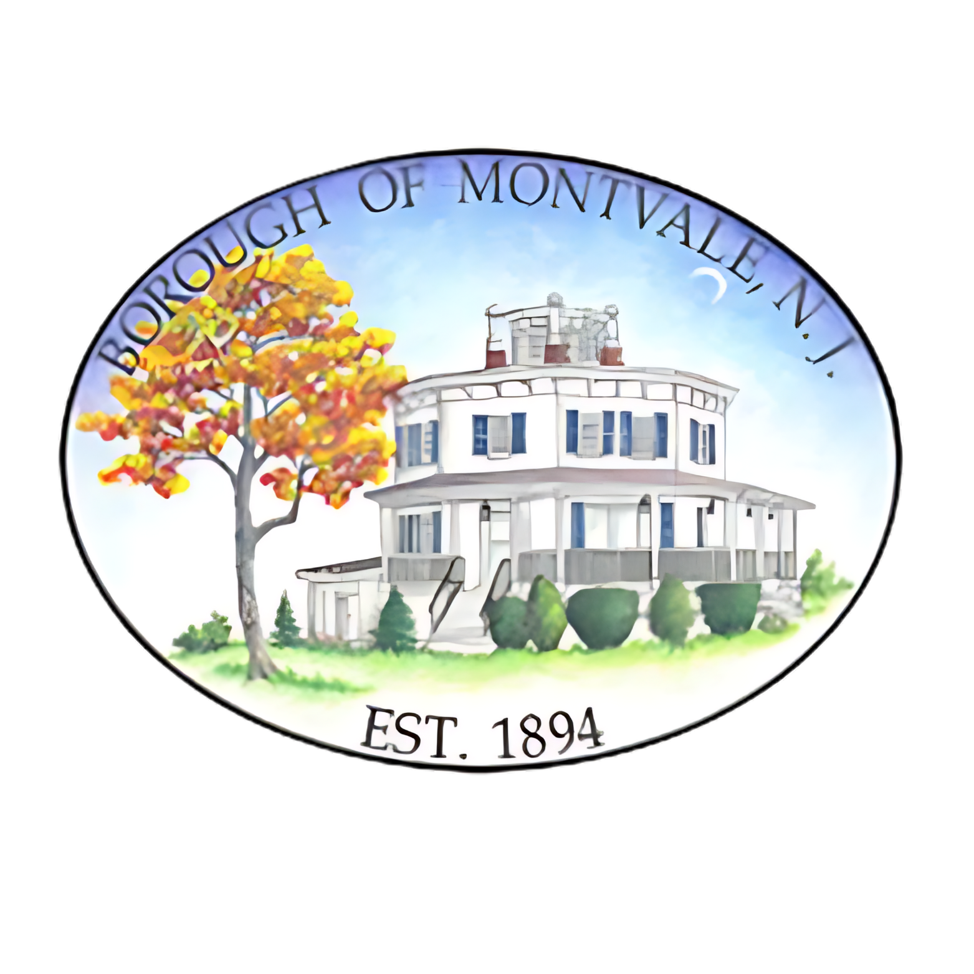
Borough of Montvale
County of Bergen
2026 Budget Overview
Investing in Our Values. Building for Tomorrow.

Slide 2
Finance Committee
Mayor Mike Ghassali
Councilman Timothy E. Lane
Councilman Chris Roche
Borough Administrator Joseph Voytus
Chief Financial Officer Matthew Cavallo

Slide 3
15+ Years of Fiscal Responsibility
Multiple years with no tax increase
Montvale has consistently kept tax increases below the rate of inflation
Efficient operations and cost-saving strategies
Conservative approach has kept the Borough financially strong

Slide 4
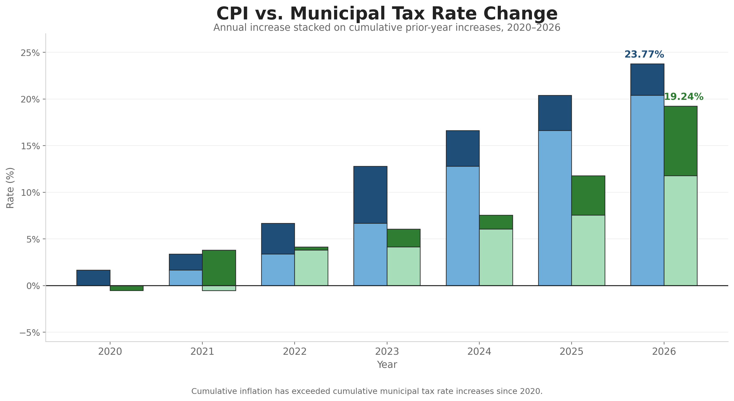
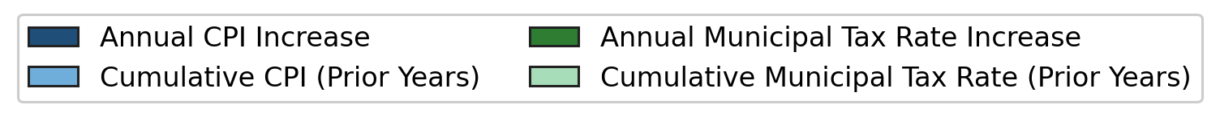
Montvale Continues To Hold The Line On Taxes
Montvale’s average municipal tax increase has remained BELOW inflation.

Slide 5
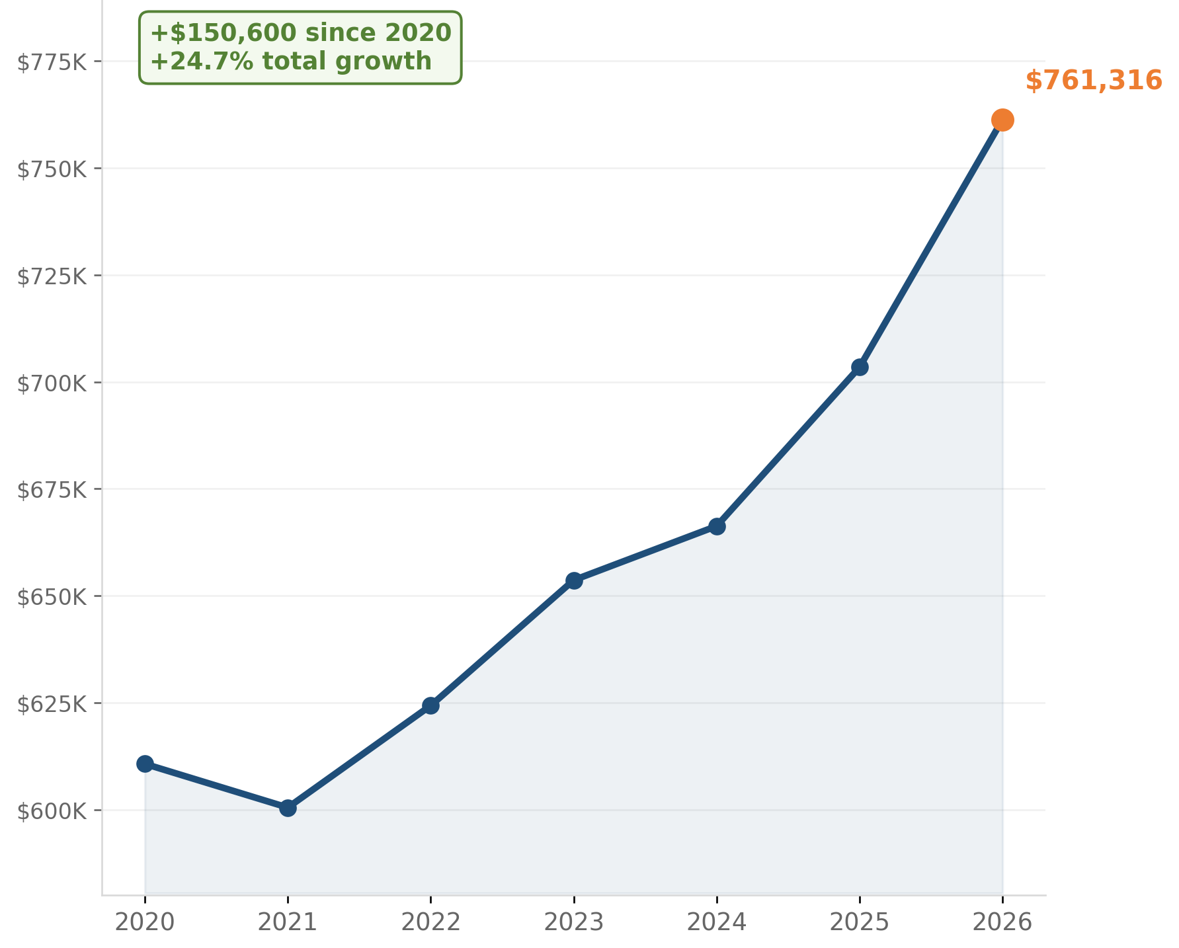
Montvale Home Values Continue To Grow
Average Equalized Home Value
$761,316
Increase Since 2020
+$150,600
Total Growth Since 2020
24.7%
Growth in Households
+174 homes
Montvale continues to balance responsible fiscal management with
long-term investment in community assets and quality of life.
Notes:
Suggested Speaking Points / Supporting Bullets
Instead of the old bullets, use:
Montvale’s residential values continue to remain strong and stable
Continued investment in infrastructure, recreation, public safety, and open space supports long-term property values
Household growth reflects continued demand to live in Montvale
Strategic planning protects both community character and homeowner investment

Slide 6
Major Cost Pressures
Driving the 2026 Budget
Many of the Borough’s largest increases are contractual, insurance-related,
utility-based, or tied to long-term capital decisions.
Cost Driver | Increase
Sewage Disposal | +13%
Fire Hydrant Service | +11%
General Liability Insurance | +9%
State Pension Obligations | +8%
Utilities | +7%
Police Contractual Increases | +7%
Workers Compensation | +6%
Police Dispatch | +6%
Employee Health Insurance
+33%
Debt Service*
+23%
*Primarily related to the DePiero Farm purchase

Slide 7
Controlling What
We Can Control
Departmental Operating Costs
↓ 0.5%
Departments reviewed operational spending line-by-line to identify reductions and efficiencies.
Salary & Wage Management
Police Dept Non-Police
↑ 7.4% ↓ 0.9%
Existing police contractual obligations significantly impacted salary costs, while non-police salary expenses decreased through staffing adjustments, vacancies, and conservative management practices.
Despite significant external cost pressures, the Borough reduced departmental operating expenses while limiting overall salary growth.

Slide 8
BUILDING A STRONGER
FINANCIAL FOUNDATION
Montvale’s reliance on surplus to support operations continues to decline.
 | 2020 | 2021 | 2022 | 2023 | 2024 | 2025 | 2026
Balance - January 1 | 4,713,174 | 4,976,873 | 5,376,214 | 5,988,687 | 6,559,806 | 6,618,515 | 7,097,766
Amount Appropriated in the CY Budget-Cash | 4,100,000 | 3,650,000 | 3,800,000 | 4,160,000 | 4,160,000 | 4,160,000 | 4,160,000
Percentage of Surplus Used in Support of Municipal Budget | 86.99% | 73.34% | 70.68% | 69.46% | 63.42% | 62.86% | 58.61%

Slide 9
Strategic Infrastructure &
Land Preservation
$5M DePiero Farm acquisition
Ongoing road resurfacing initiative
Renewing and revitalizing parks, fields and open space
Investments in fire safety equipment, radios, license plate readers, SCBA and PPE
Investments tied to increasing home values, public health and safety, and livability

Slide 10
Strategic Investment.
Responsible Financing.
AAA Bond Rating
  S&P reaffirmed Montvale’s AAA rating in 2025
  Allows borrowing at the lowest available interest rates
  Reflects strong financial management and stability
Long-term Community Investments
  $5M DePiero Farm preservation initiative
  Road resurfacing and infrastructure improvements
  Parks, recreation, and public safety investments
  Protects against overdevelopment and preserves quality of life
Responsible Debt Management
  Financing aligned with long-life community assets
  Costs spread fairly across future beneficiaries
  Debt service increase of approximately $272,000 remains within sustainable limits

Slide 11
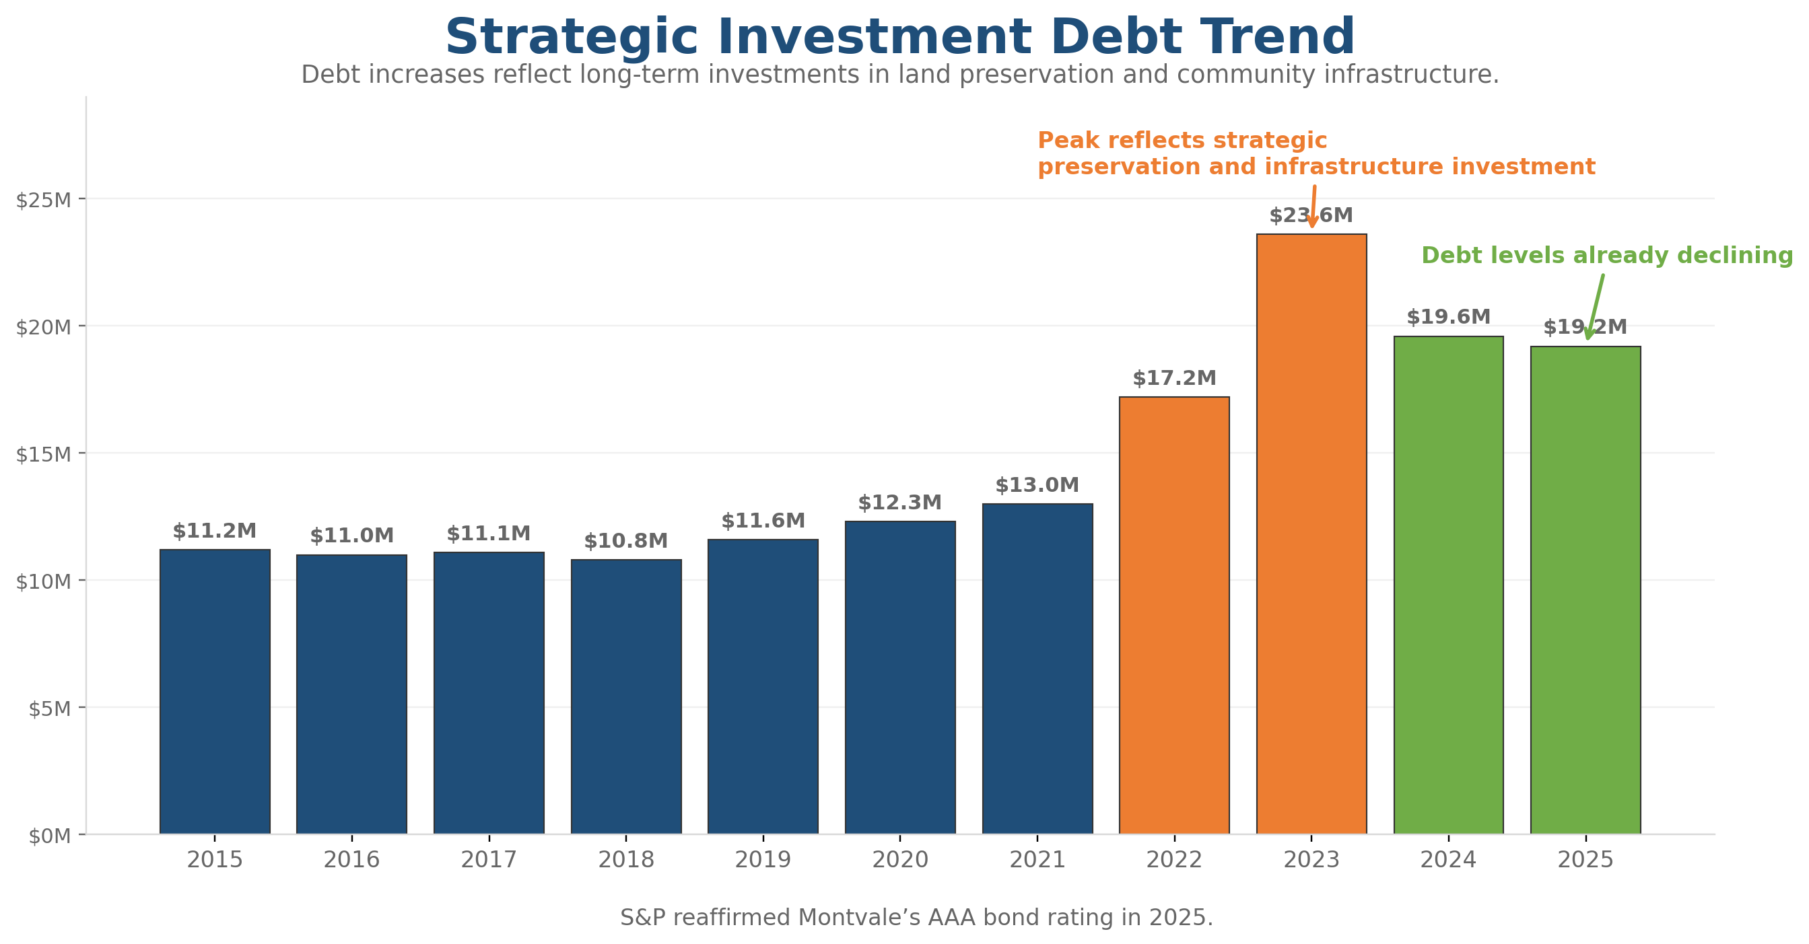
Building a Better Montvale:
STRATEGIC INVESTMENTS WITHIN SUSTAINABLE LIMITS
Montvale has strategically utilized debt to finance long-term community assets, infrastructure, and land preservation initiatives that will benefit residents for generations. Despite these investments, the Borough continues to maintain strong financial reserves and a AAA bond rating reaffirmed by S&P in 2025.

Slide 12
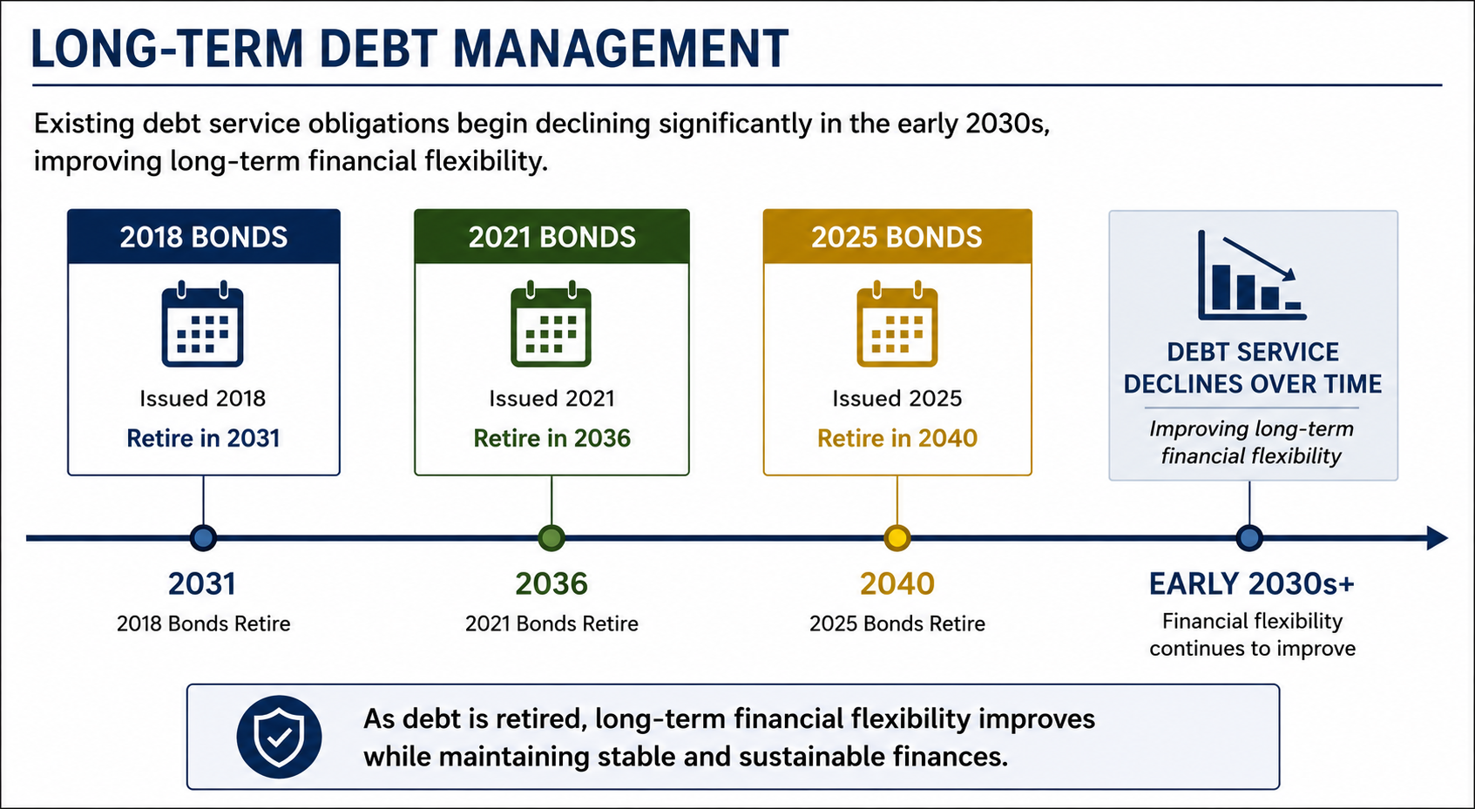
Strategic Capital Planning
Montvale strategically aligns future capital investments with retiring debt to maintain long-term financial stability.
Existing debt service obligations begin declining significantly in the early 2030s.
Long-term financial flexibility improves as debt is retired.
Supports stable and sustainable financial planning.
Allows the Borough to responsibly evaluate future capital priorities over time.
Maintains alignment with Montvale’s AAA bond rating and long-term fiscal strategy.

Slide 13
Shared Services Update
Managing Costs Through Regional Partnerships
DPW Shared Services Agreement
  Triennial review completed with River Vale
  Montvale’s share increased following an independent cost allocation study
  $220,000 adjustment on a $4 million DPW budget reflects updated service allocation
Joint Municipal Court
  Revised funding formula provides a fairer allocation of shared court costs
  Estimated to save Montvale approximately $100,000 annually once fully phased in
  Judge Randazzo confirmed by Governor Murphy to continue serving the Joint Municipal Court
Shared services remain an important tool for controlling costs, improving fairness, and maintaining essential services.

Slide 14
Revenue Enhancements & Cost Controls
Maximizing Every Dollar
Banking interest earnings increased
Open Space Trust Fund offsets eligible capital costs
Joint Municipal Court revised funding formula estimated to save approximately $100,000 annually once fully phased in
Departmental operating expenses reduced through line-by-line review
Employee participation in HDHP helps mitigate health insurance increases
Continued AAA bond rating supports lower borrowing costs and long-term financial stability

Slide 15
Open Space Trust Fund:
PROTECTING MONTVALE’S OPEN SPACE,
HISTORY & QUALITY OF LIFE
Funded by the 1999 voter-approved referendum
$2.6M invested to date
Generates approximately $462K annually for open space, recreation, and historic preservation initiatives
2025–2026 Project Highlights
Historic Preservation: Octagon House
Community Investment: Montvale Community Garden
Parks & Recreation: Huff Park Pavilion
The Open Space Trust Fund continues to preserve Montvale’s character while supporting recreation, history, and quality-of-life improvements.

Slide 16

Where Your Tax Dollar Goes:
How Every $100 of Your Taxes Is Spent
Municipal
$24.43
Municipal Open Space
$0.74
Library
$1.70
Local Schools
$35.28
Regional School
$26.76
County
$10.72

Slide 17
Capital Project Highlights:
Investments That Build Community
Public Safety
  Firehouse construction to support emergency response for decades to come
  Continued investment in fire safety equipment, radios, SCBA, and PPE
Parks & Recreation
  Huff Park upgrades, playgrounds, turf infields, pickleball, and bocce
  Upcoming Huff Park Pavilion
  Montvale Community Garden
Library & Public Facilities
  Reading garden, new carpeting, HVAC upgrades, and LED lighting retrofits
DPW & Infrastructure
  New equipment, vehicles, road resurfacing, and parking lot improvements
Open Space & Historic Preservation
  Continued investment in DePiero Farm and Octagon House restoration
  Supports preservation, controlled development, and quality of life

Slide 18
Summary:
RESPONSIBLE TODAY. PREPARED FOR TOMORROW
Average municipal tax impact: $248.90 per year
Equivalent to approximately $20.74 per month for the average home
Maintains essential services while investing in infrastructure, public safety, parks, and open space
Preserves healthy surplus and supports Montvale’s AAA-bond rating
Reflects long-term planning and resident priorities from the 2024 survey

Slide 19
Financially Strong.
Future Focused.
Montvale’s 2026 budget reflects responsible fiscal management and long-term investment in the community.
  AAA Bond Rating Maintained
  Healthy Surplus Preserved
  Average Tax Increases Remain Below Inflation
  Departmental Operating Costs Reduced
  Major Investments in Open Space, Infrastructure, and Public Assets
Financially strong. Operationally disciplined. Focused on the future.

